Slide 1
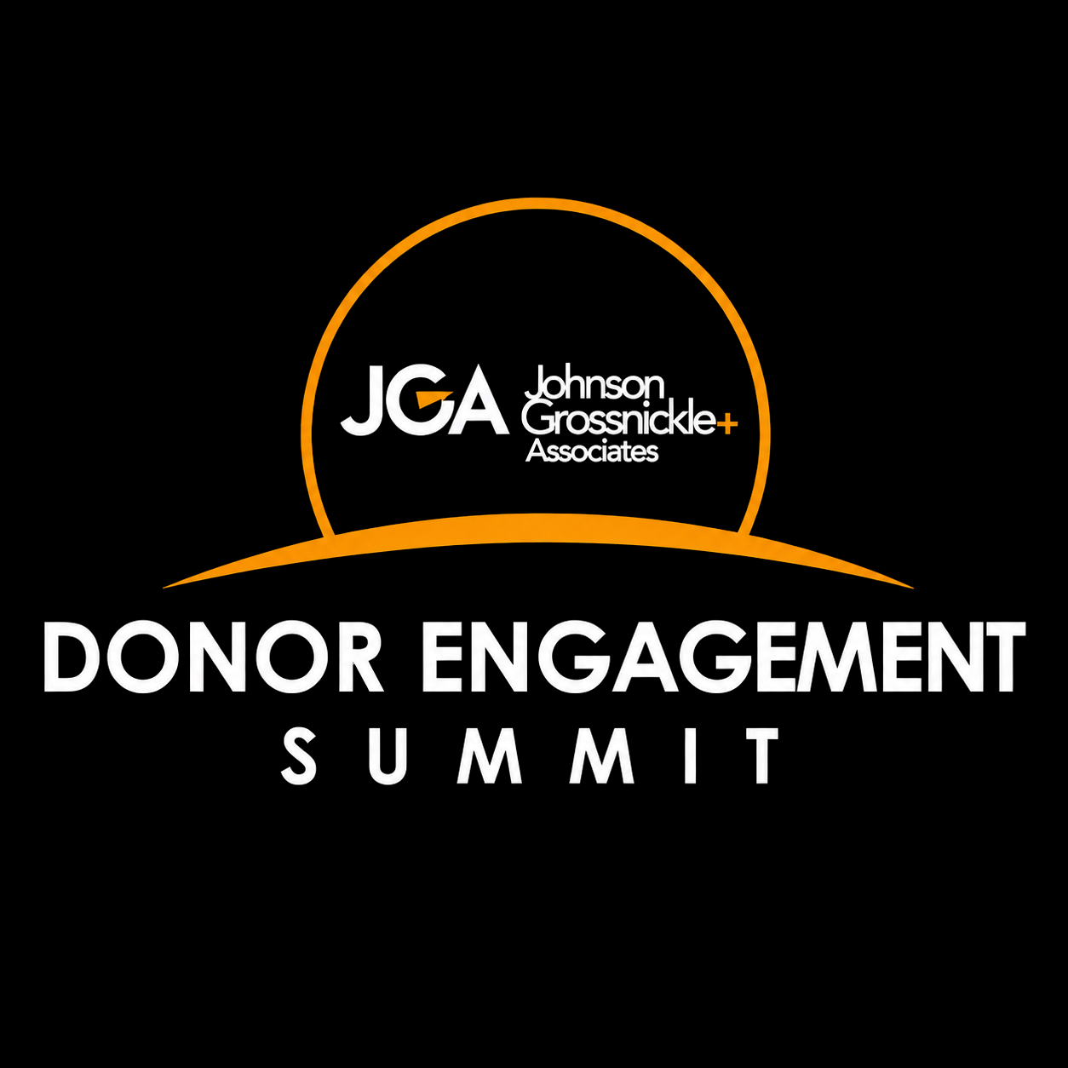
2026 Donor Engagement Summit

Slide 2
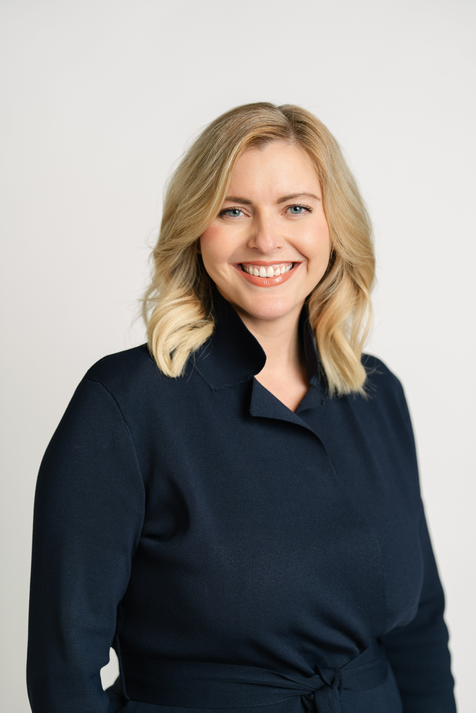
Welcome
Lee Ernst
CEO and Senior Consultant
JGA

Slide 3
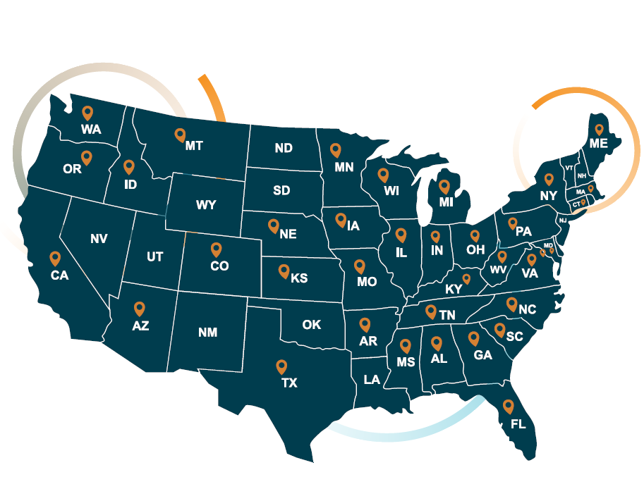
About JGA
Building Trust Through Every Story
In our more than 30 years, JGA empowers nonprofits to achieve transformational results for their communities.
More than 99% of JGA clients who have entered a campaign
either met or exceeded their goal.
Our leadership roles with premiere philanthropic organizations—including The Generosity Commission, The Giving Institute, and Indiana University Lilly Family School of Philanthropy—ensure our work reflects the highest level of national conversations around philanthropy.
Since 2002, JGA has been an Employee Stock Ownership Plan (ESOP) firm, giving each team member a vested interest in the success of our clients.
JGA invests in innovation by developing proprietary data tools and partnering with leading nonprofit technology firms—equipping our clients with insights to sharpen donor strategy.
National consulting firm, actively work in approximately 20 states at any given time, JGA provides feasibility studies, campaign counsel, strategic planning, readiness work, and predictive analytics to drive sustainable growth.

Slide 4

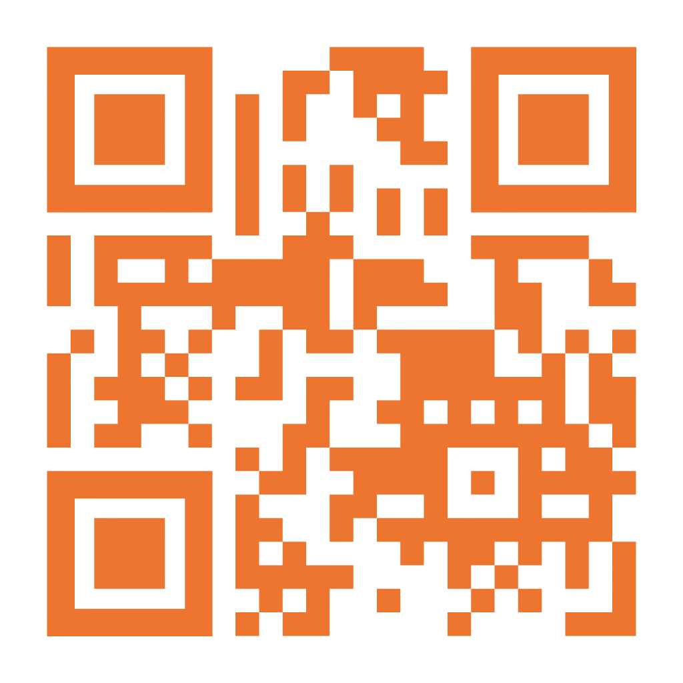
Scan to view the full agenda online or view the printed copy given upon entrance.
Agenda

Slide 5


Curiosity Code:
Building a Culture of Curiosity to Thrive in the AI Era
Nathan Chappell, MBA, MNA, AIGP, CFRE
Chief AI Officer, Virtuous

Slide 6


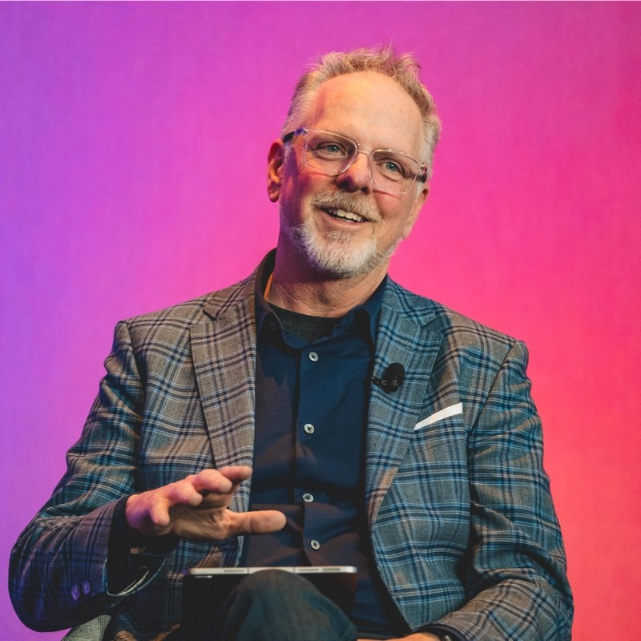
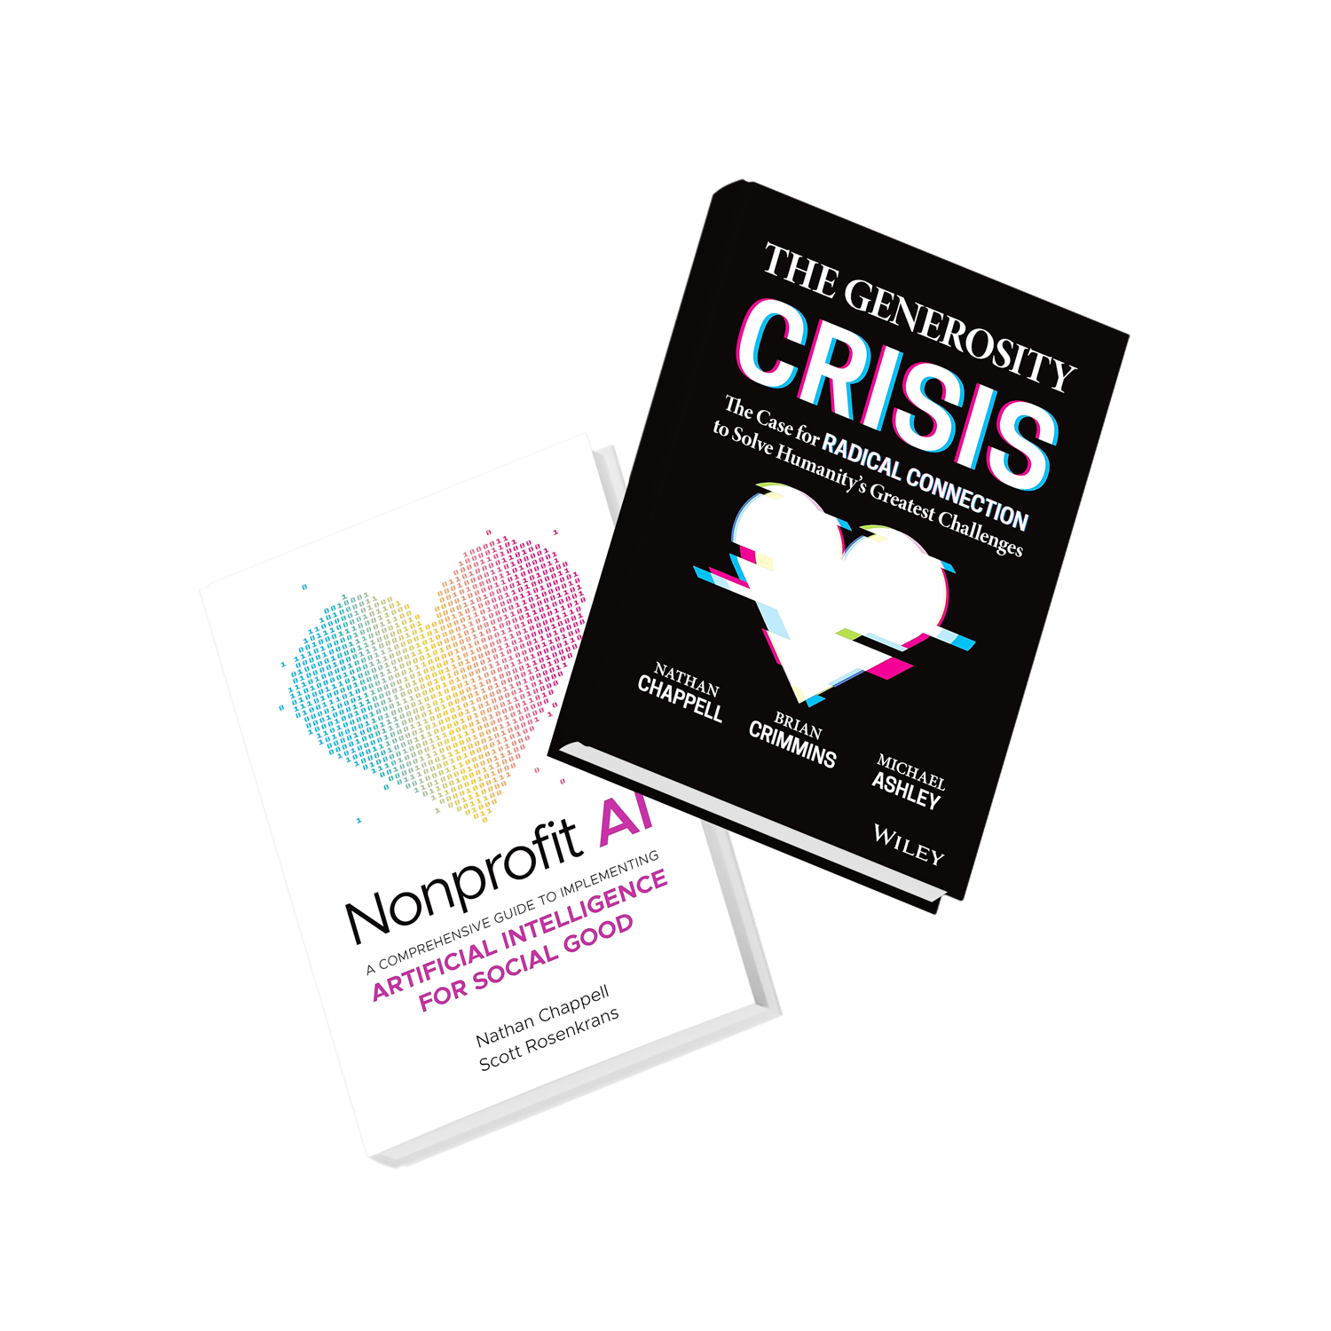
Nathan Chappell
MBA, MNA, AIGP, CFRE
Experience
20+ Year Nonprofit Leader
3X Entrepreneur
2X Published Author
2X AI Patents
Chief AI Officer, Virtuous
Recognition
Global Keynote Speaker
TEDx Speaker
Tech Advisor
Founder Fundraising.AI
Podcast Host

Slide 7

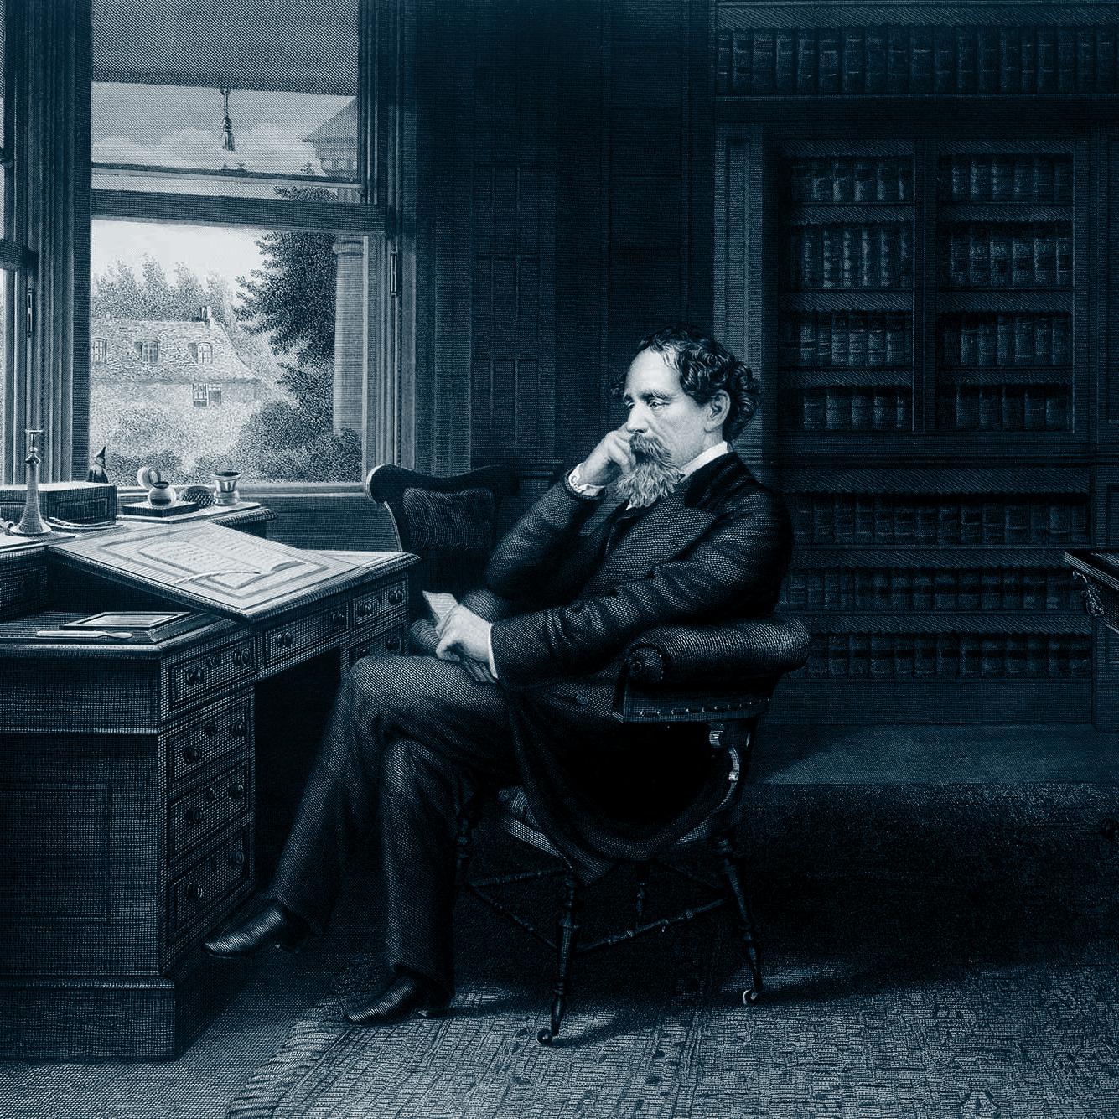

“It was the best of times, it was the worst of times, it was the age of wisdom, it was the age of foolishness, it was the season of Light, it was the season of Darkness, it was the spring of hope, it was the winter of despair, we had everything before us, we had nothing before us.”
A Tale of Two Cities by Charles Dickens, published in 1859

Slide 8





Separating AI hype from AI reality.
“Here’s how the Crash Happens”
“These AI Power Users Are Impressing Bosses and Leaving Co-Workers in the Dust”
“Perhaps OpenAI or Anthropic will pull off superintelligence, allowing them to, create God and then ask it for money."

Slide 9
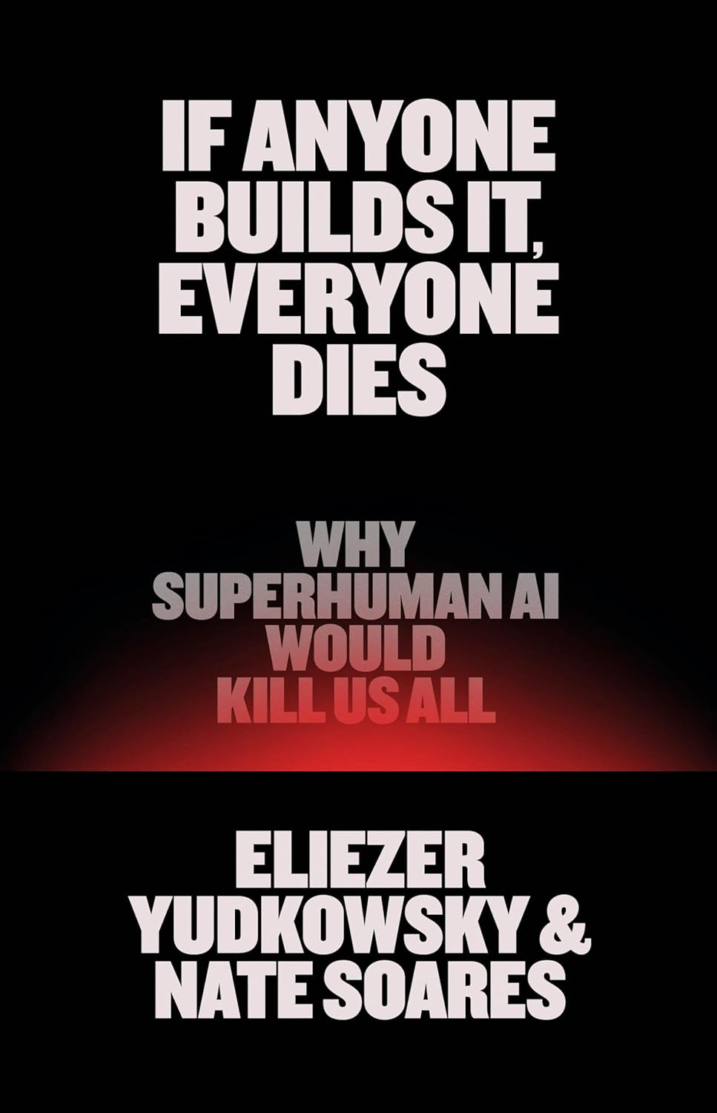

Separating AI hype from AI reality.

Slide 10
Separating AI hype from AI reality.
Notes:
One thing both have in common is the at AI holds the power to transform work, society and the the future of humanity

Slide 11
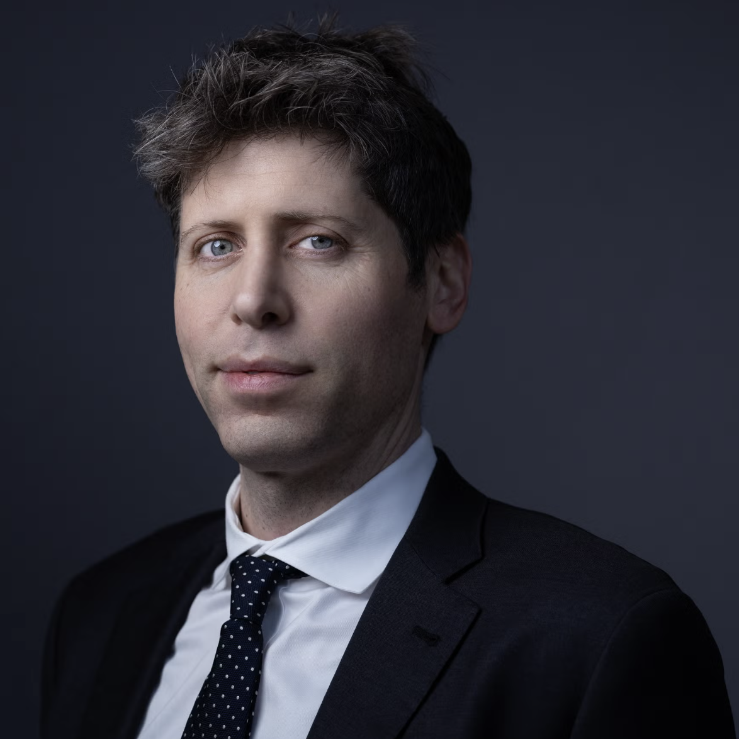
“The world is about to change more in the next 5 years than it did in the last 50.”
Sam Altman
Notes:
It means that we better get comfortable with change. - Statistically, only 20% of people like change, 50% of people sit on the sidelines, and 30% of the people actively work against change.
It's said that people don't mind change… they just don't like being changed.
WHo moved my cheese? AI did.

Slide 12
Our shared reality.
AI dwarfs all other technologies combined.
Notes:
BUT only if the challenges of present exceed the discomfort of change.
But what does that even mean?

Slide 13
You can't build a culture of curiosity on a foundation of fear.
And you can't innovate if you feel like you're already failing.

Slide 14
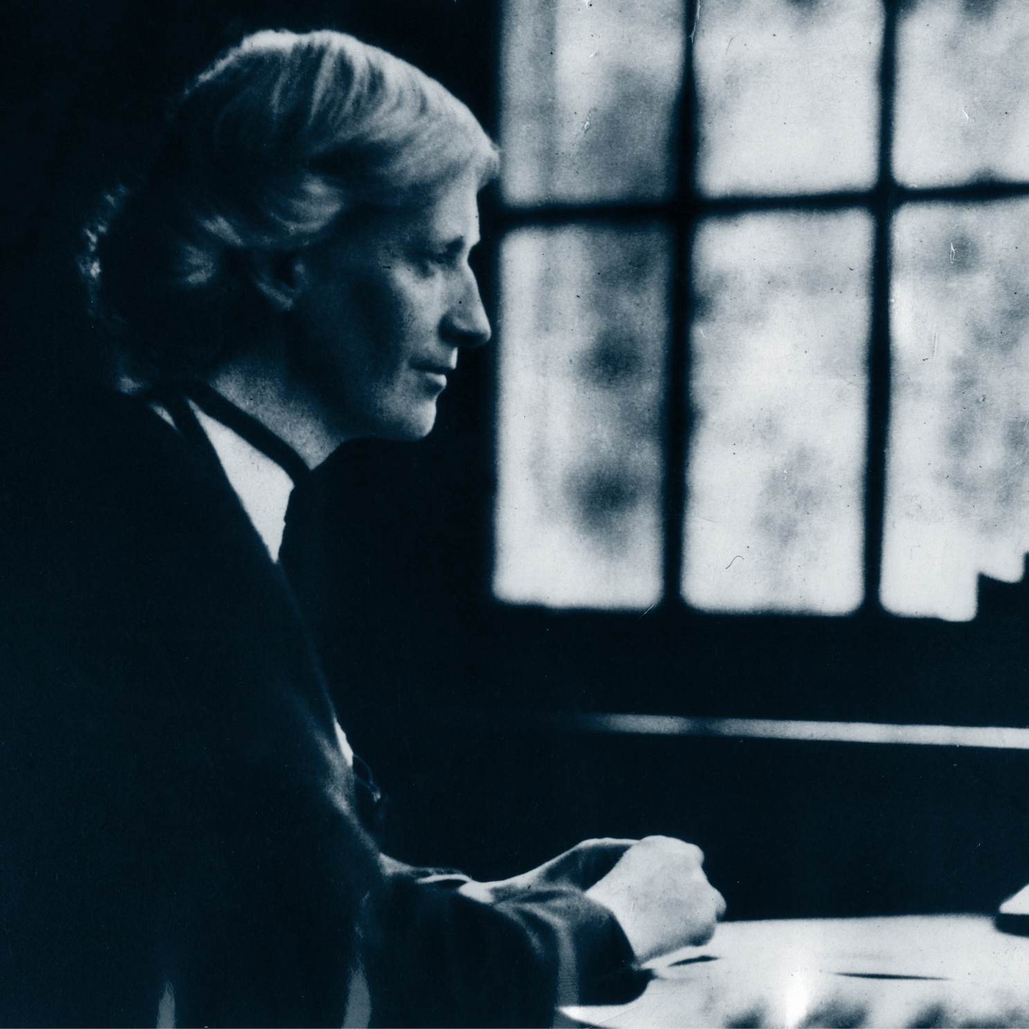
“We have to devise means of making known the facts in such a way as to touch the imagination of the world. The world is not ungenerous, but unimaginative and very busy.”
Eglantyne Jebb, Founder of Save the Children, circa 1923
Notes:
Part of the reason your job isn't getting easier is what we call in the generosity crisis as the competition for connection.
But the competition for connection is significant
The average person scrolls 300 feet on their phone a day and sees 5,000 algorithms.
Non-profits aren't in the business of raising money. They're in the business of building connection.

Slide 15

New reality. New rules.
1900s
1945
Now
Knowledge DOUBLED roughly every 100 years.
Knowledge DOUBLED roughly every 25 years.
Knowledge
DOUBLES roughly every 12 hours.
Notes:
Intelligence explosion.

Slide 16
Our shared reality.
Incremental change won't work in an exponential age.
Notes:
It also means that...

Slide 17
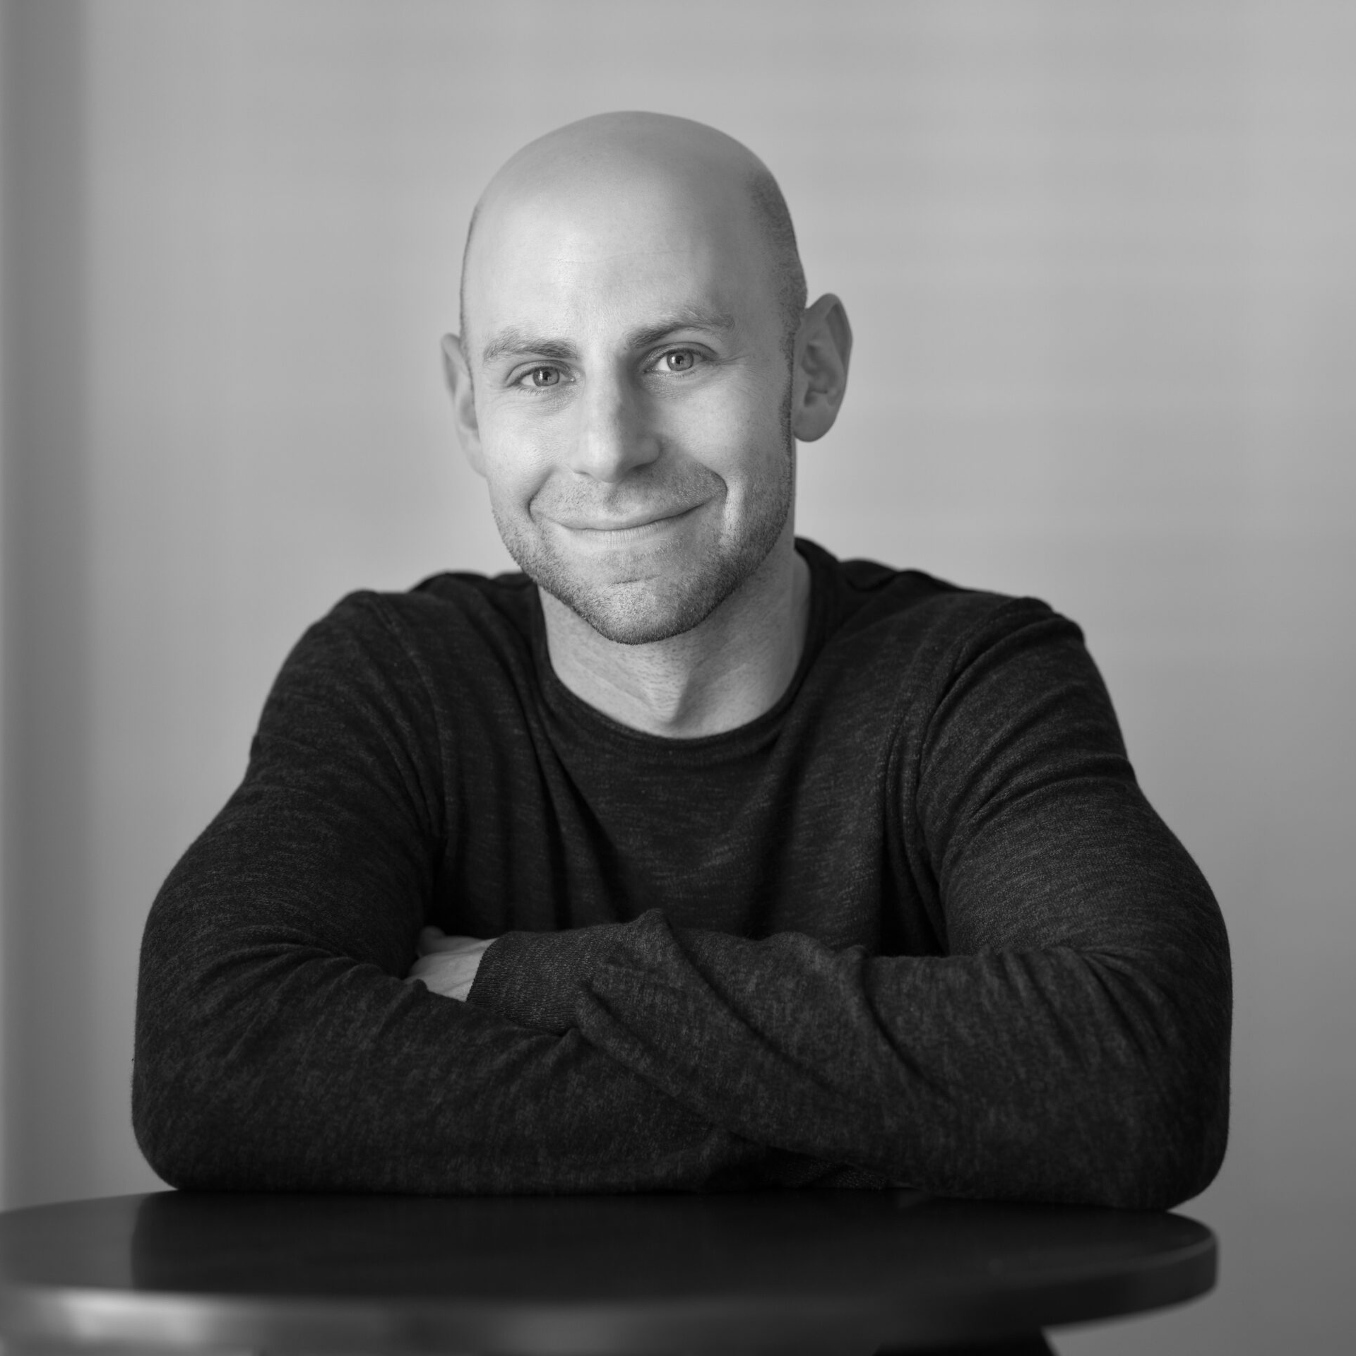
“The hallmark of expertise is no longer how much you know; it's how well you synthesize.
Information scarcity rewarded knowledge acquisition, but information abundance requires pattern recognition.
It's no longer enough to collect facts. The future belongs to those who connect dots.”
Adam Grant, organizational psychologist, author, and professor
Notes:
Part of the reason your job isn't getting easier is what we call in the generosity crisis as the competition for connection.
But the competition for connection is significant
The average person scrolls 300 feet on their phone a day and sees 5,000 algorithms.
Non-profits aren't in the business of raising money. They're in the business of building connection.

Slide 18
human intelligence
synthetic intelligence
human creativity
synthetic creativity
AI enablement
wisdom + discernment + passion
distraction - bureaucracy - burnout
The new math of success
Notes:
Got you here, but it won't get you there.
Success is modeled as a multiplicative system where human intelligence (I_H) and creativity (R_H) are augmented by synthetic intelligence (I_S) and synthetic creativity (R_S). Curiosity (C), wisdom/discernment (W), adaptability (A), and passion (P) act as compounding human multipliers. \rho and \eta represent how effectively someone harnesses AI tools, \kappa captures how AI expands the set of reachable opportunities, the \alpha exponents weight each factor’s importance, and \text{Friction} (scaled by \lambda) reduces outcomes due to constraints like distraction, bureaucracy, or burnout.
THIS FORUMLA DOES NOT CONSIDER:
E = execution/discipline (turning insight into shipped work)
S = social capital (relationships, trust, sponsorship)
V = values/integrity (especially relevant in responsible AI contexts)
K = context fluency (domain understanding, not just tool skill)
\epsilon = luck/noise term (because life is not a spreadsheet)

Slide 19
INTELLIGENCE
PASSION
Curiosity + adaptability is the closest thing to a durable advantage that exists right now.
CURIOSITY
STRATEGY
ADAPTABILITY
CREATIVITY

Slide 20
What’s your CQ?
AI can process data, generate insights, and create beautiful things. But it can’t wonder.
That’s your job.
Notes:
“What AI does not do is pause. It does not ask whether something should be built, or how it might reshape human experience over time. - That responsibility still belongs to us.”

Slide 21
[7] tips for AI success
Curiosity is not something we learn - it’s something we’re born with.
The real challenge isn’t gaining curiosity but protecting it from a world that tries to tame it.
Notes:
The competition for connection, 5,000 algorithms, 300 feet, scrolling, etc.
Find a place to dream - no phone zone

Slide 22
[1]
Ask how can AI help
The AI-forward mindset asks: "What if?” habitually.
Spend one hour a day experimenting with AI.
Not passively reading about it. Using it.

Slide 23
[2]
Experiment perpetually
Try new things even when the current thing is working. Get comfortable being a beginner repeatedly.

Slide 24
[3]
Practice old problems
Practice looking at old problems with a beginner's mind.

Slide 25
[4]
Express your imagination
Give yourself permission to color outside the lines
without judgement.
Notes:
Reward the uncomfortable feeling when learning something new.

Slide 26
[5]
Habitually humble
Assume the way you’ve always done something is not the best or only way.

Slide 27
[6]
Cherish boredom
To realize your full potential with AI requires that you
step away from technology in equal proportion.
Create boundaries and protect a no-tech zone like your career depends on it.

Slide 28
[7]
Wonder daily
Write down 1 thing that surprised you every day.

Slide 29
Assume anything is possible.
Be willing to be proven wrong.

Slide 30
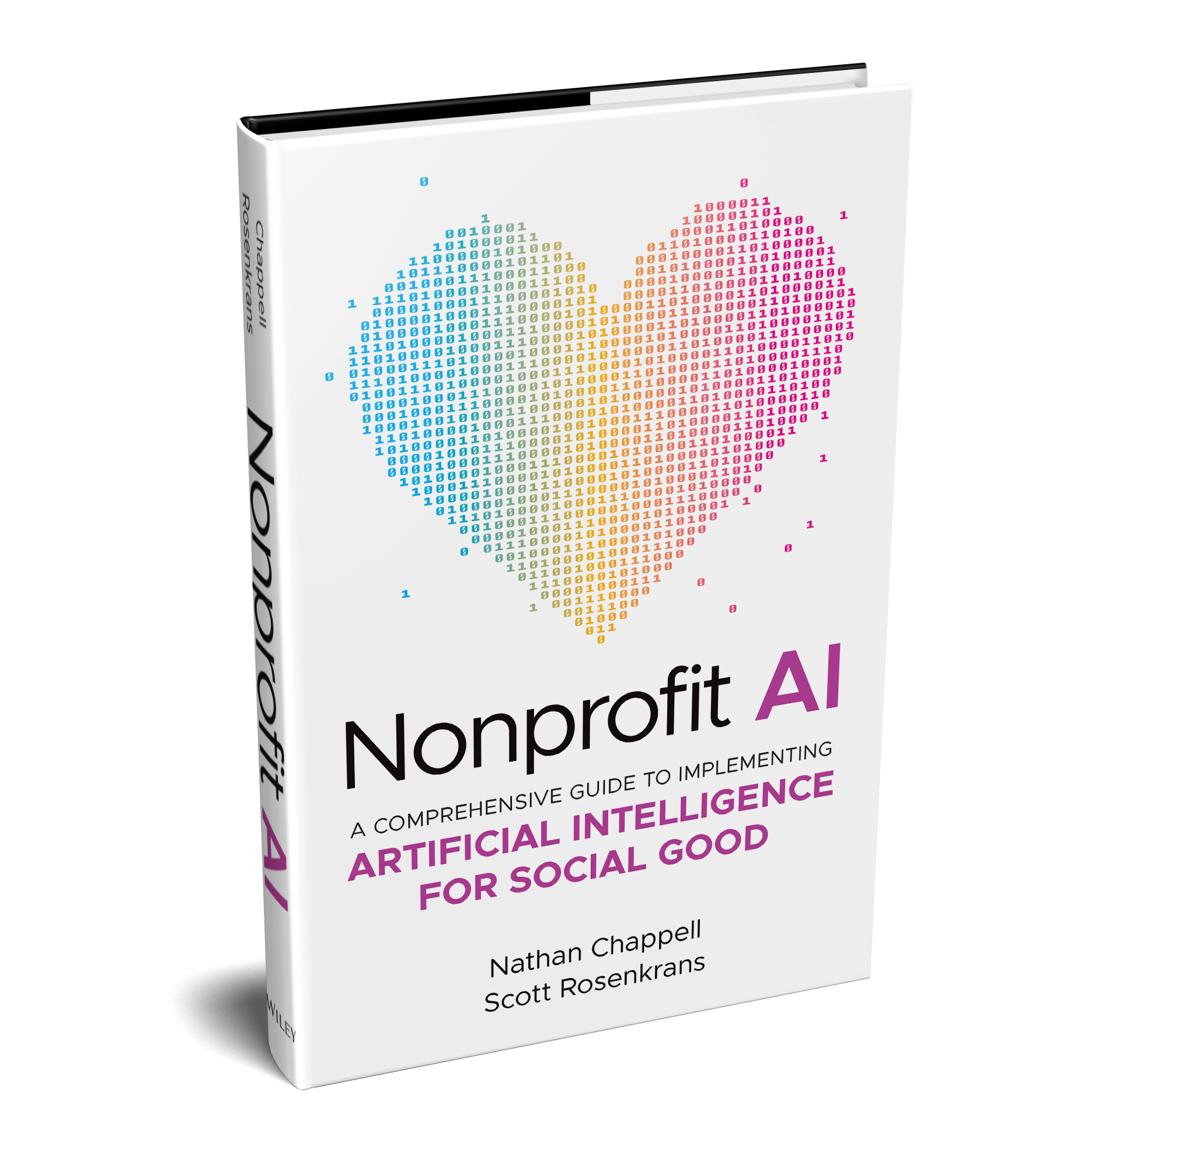
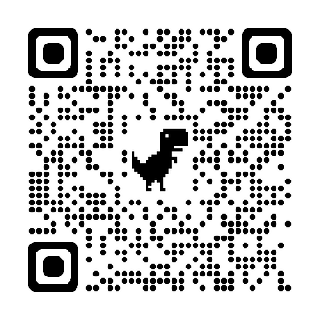
Special VIP Download
=

Slide 31
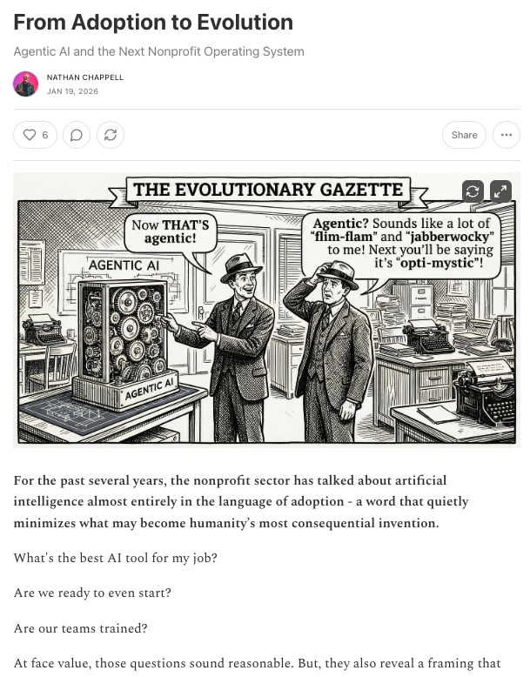
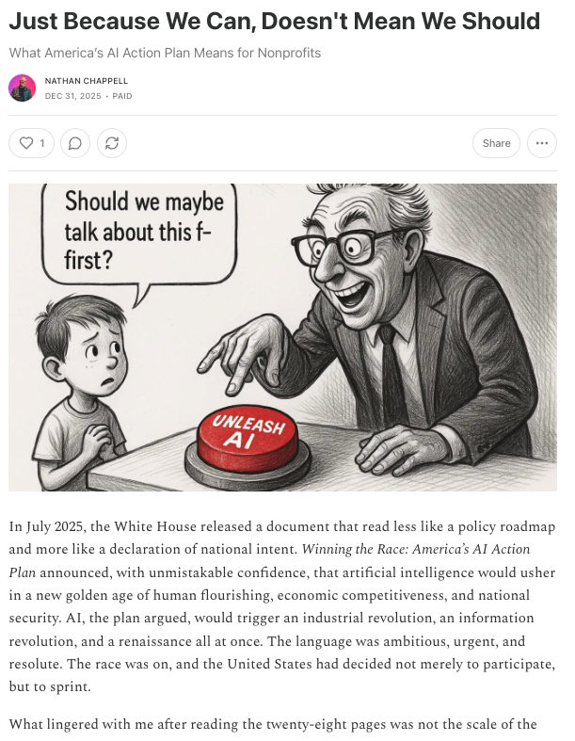
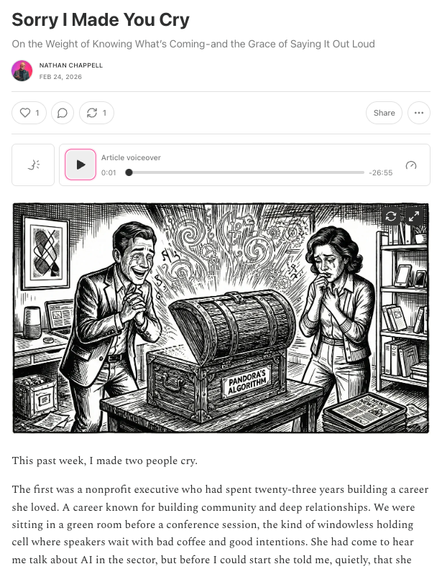
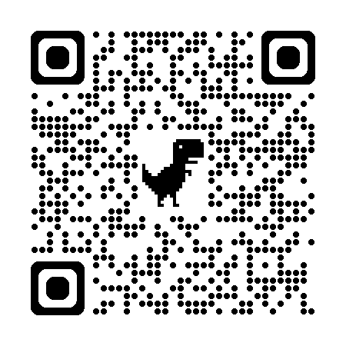
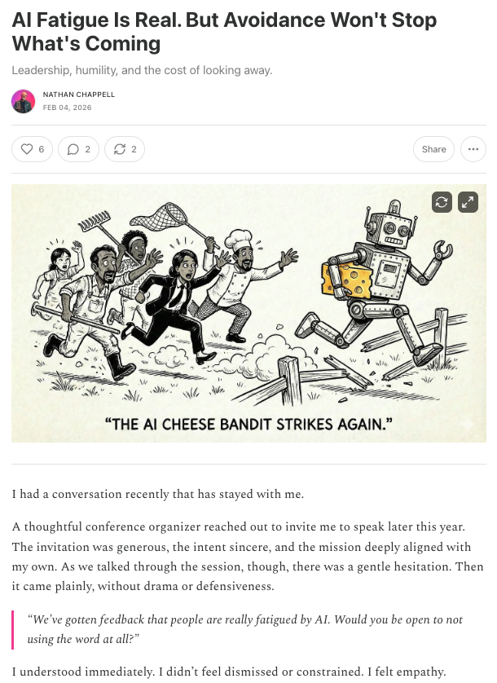
Stay connected
Nathan Chappell, MBA, MNA, AIGP, CFRE
nathanchappell.com
nathan.chappell@virtuous.org
714.357.6148

Slide 32

The Future of Donor Engagement:
A Conversation with Nathan Chappell

Slide 33
Panelist and Moderator
Panelist
Nathan Chappell
Chief AI Officer
Virtuous
Moderator
Lee Ernst
CEO and Senior Consultant
JGA

Slide 34
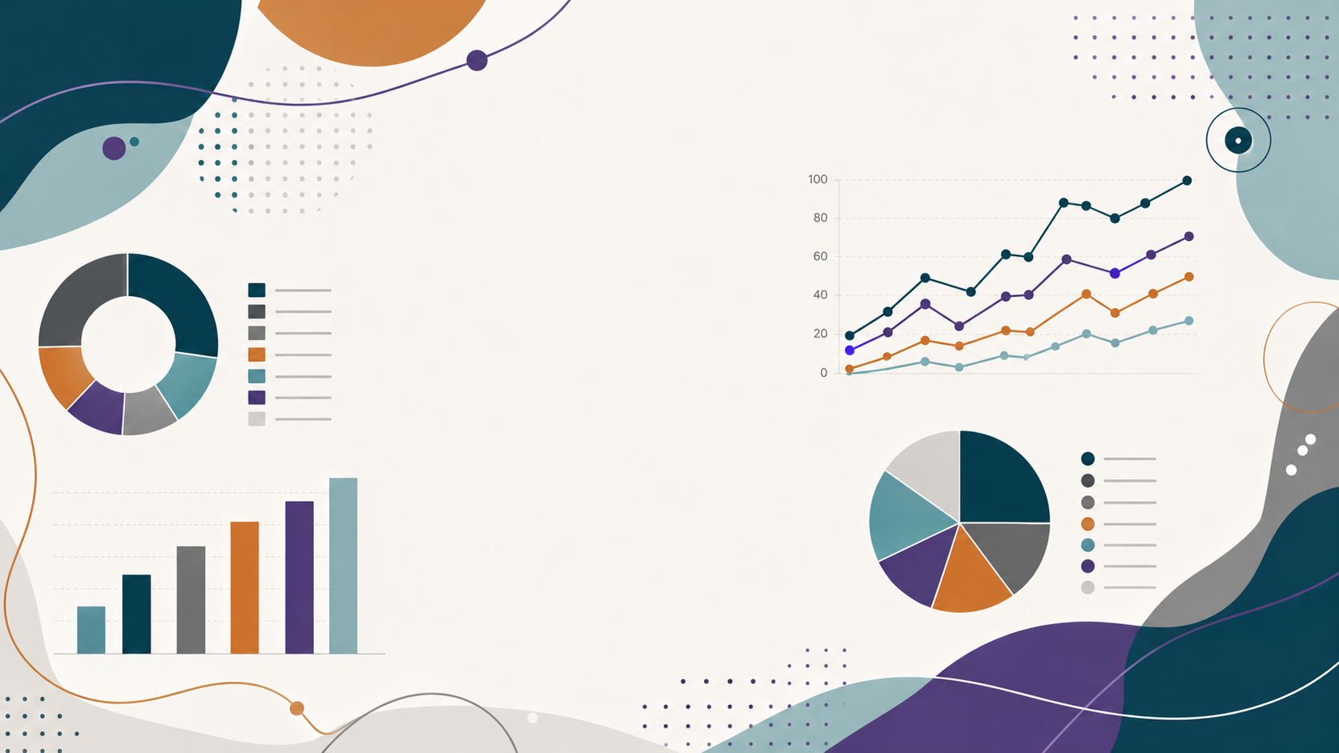
AI-Powered Fundraising in Practice
A Practical Guide to Personalized Donor Engagement

Slide 35
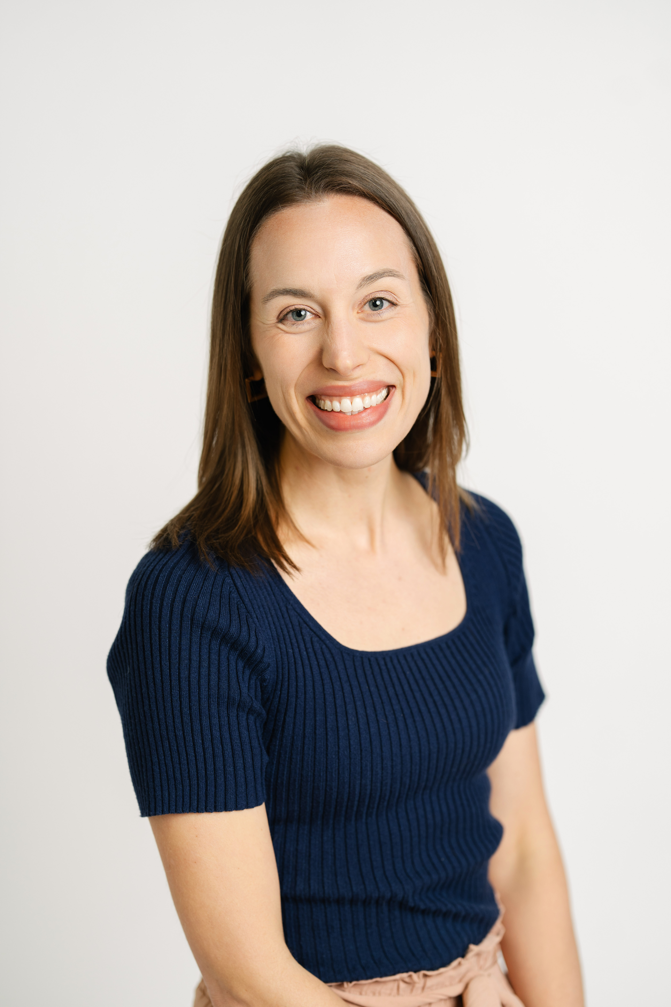
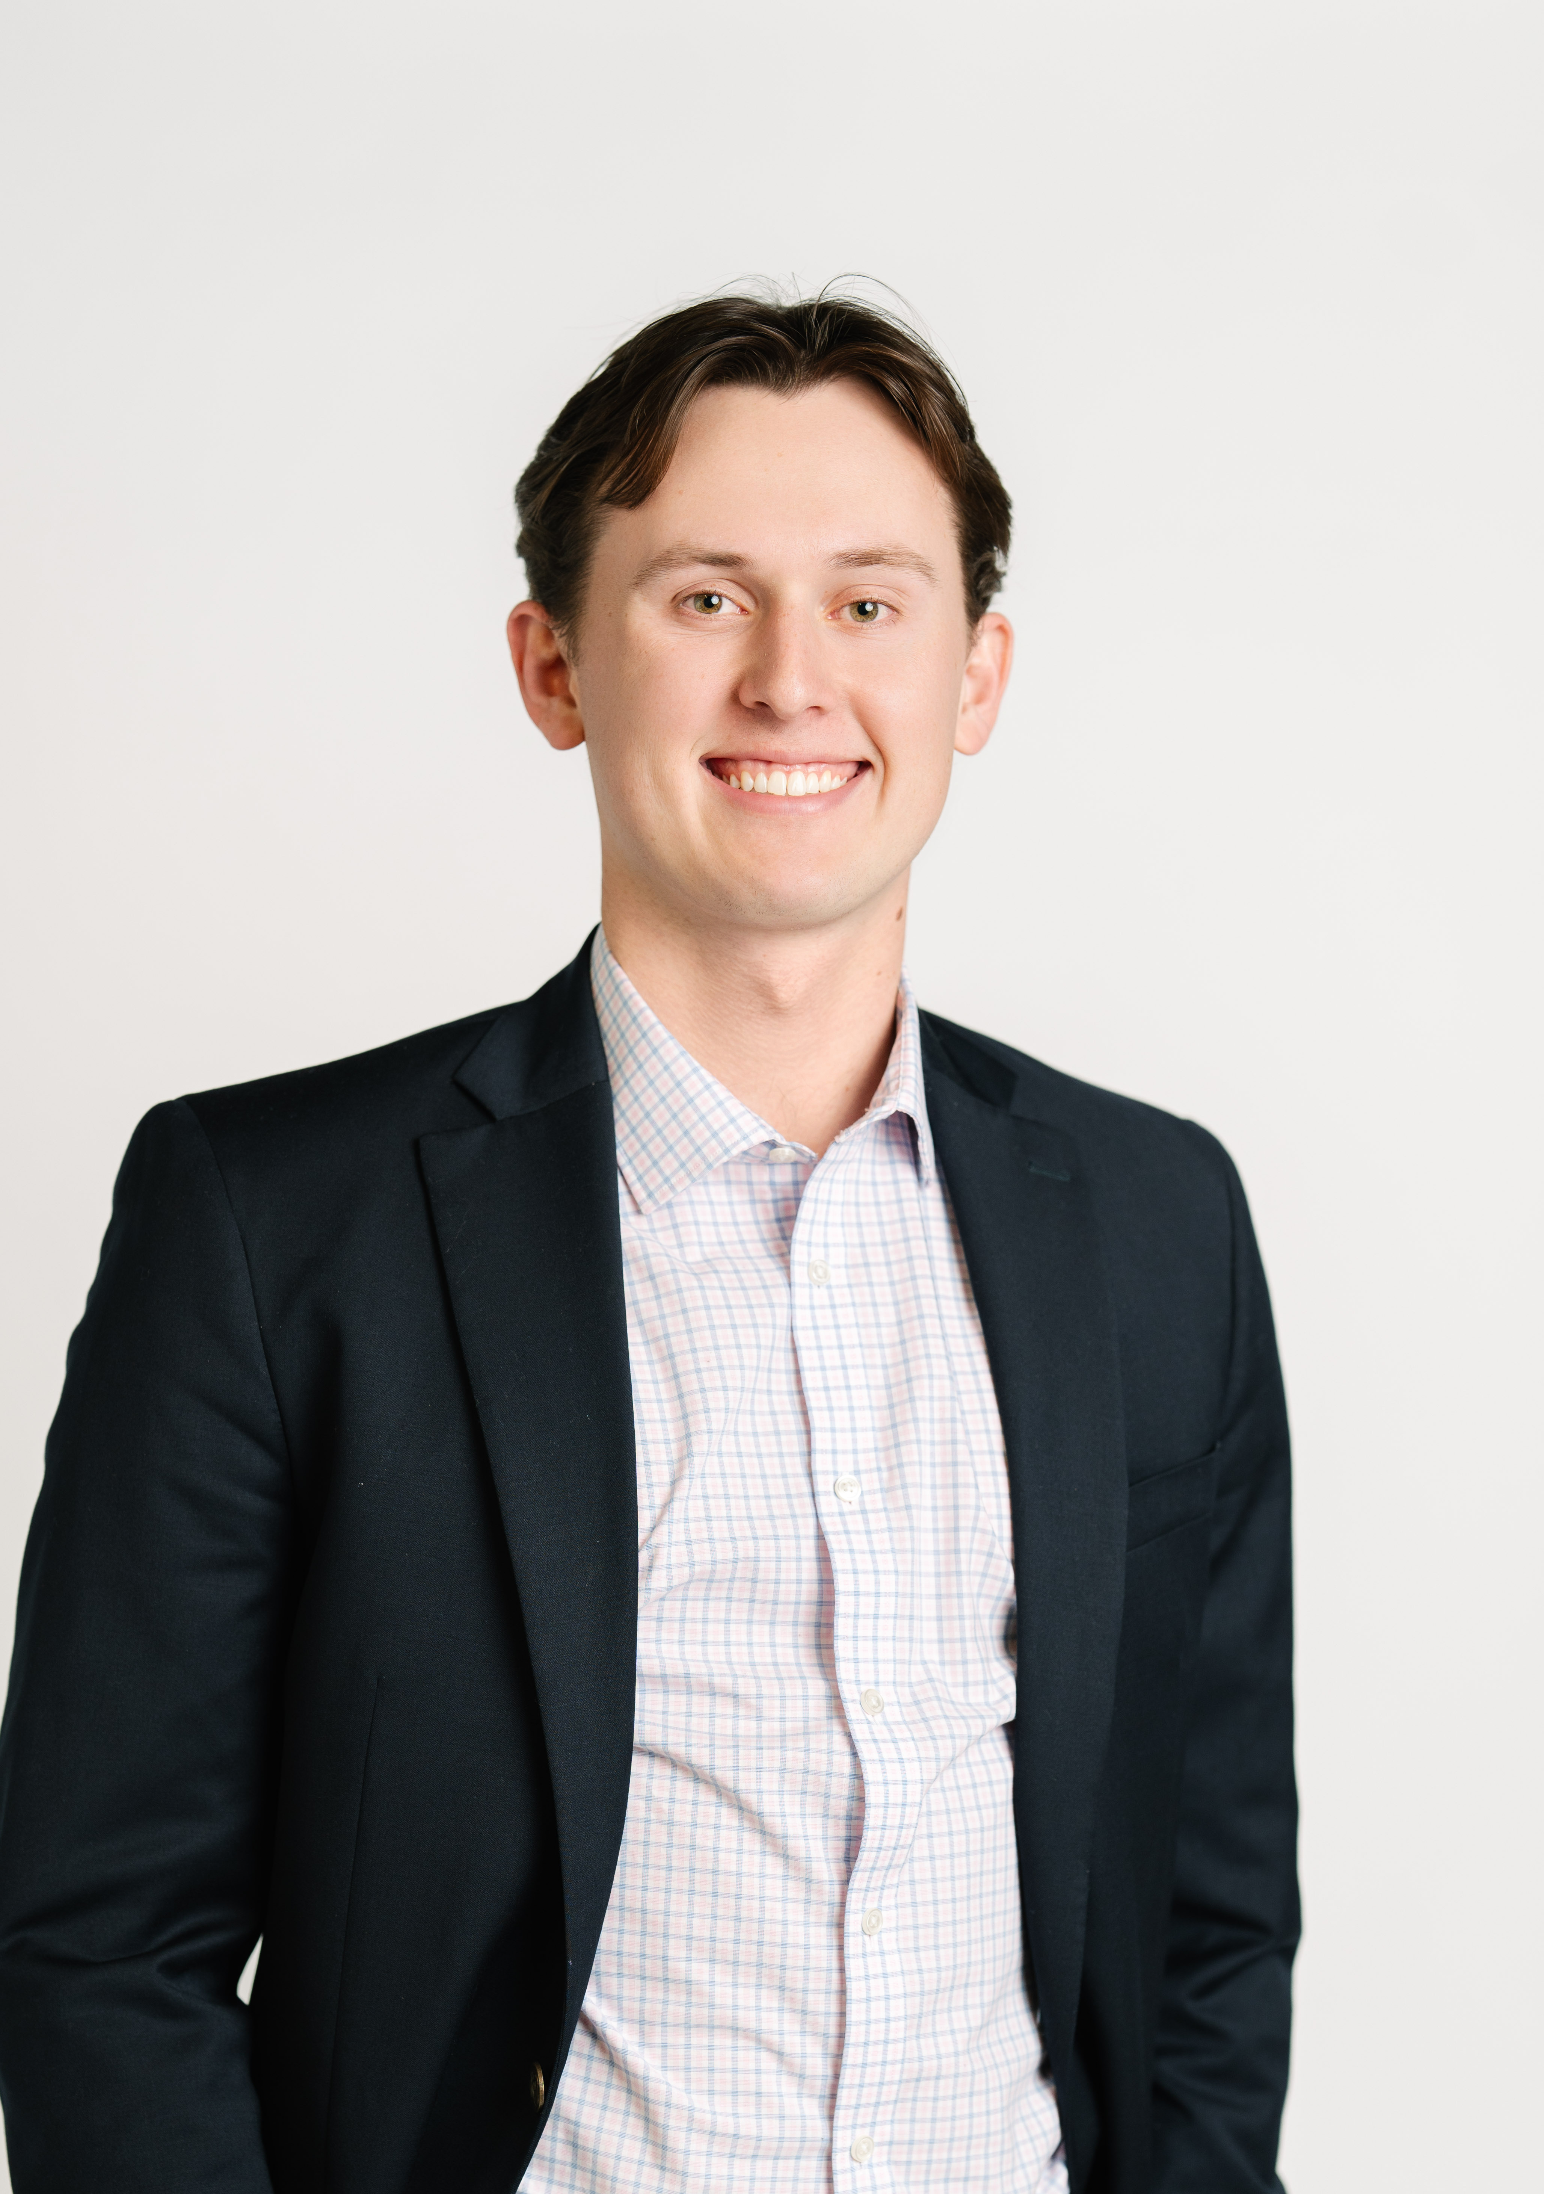
Presenters
Carrie Rickenberg
Consultant
JGA
Cole Borden
Data Analyst
JGA

Slide 36

What We Hear From Fundraisers Everyday
  The Challenge
  Gift officers are stretched thin— more touchpoints, less time.
  The Risk
  Outreach becomes generic and relationships become transactional.
  The Opportunity
  AI handles the heavy lifting so fundraisers focus on what only they can do.

Slide 37

How We’ll Tackle the Challenge
AI isn't here to replace the fundraiser. It's here to help you spend less time searching for insights and more time building meaningful donor relationships.
We'll bring that idea to life by walking through three real-world donor profiles and creating personalized engagement strategies together in real time.

Slide 38
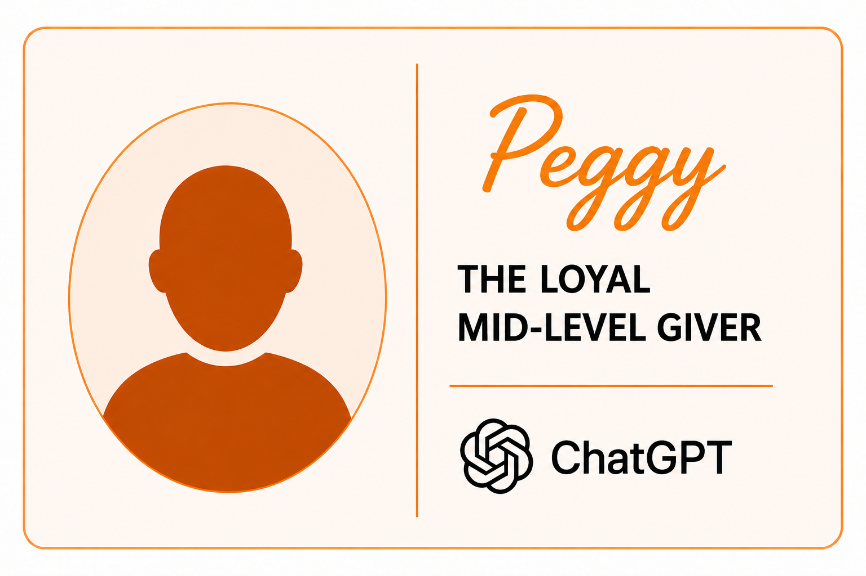
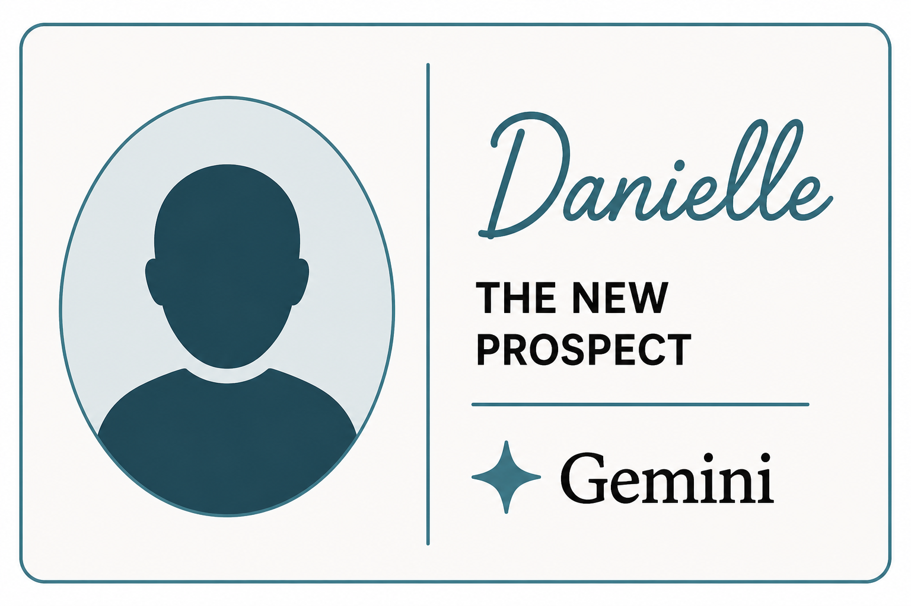
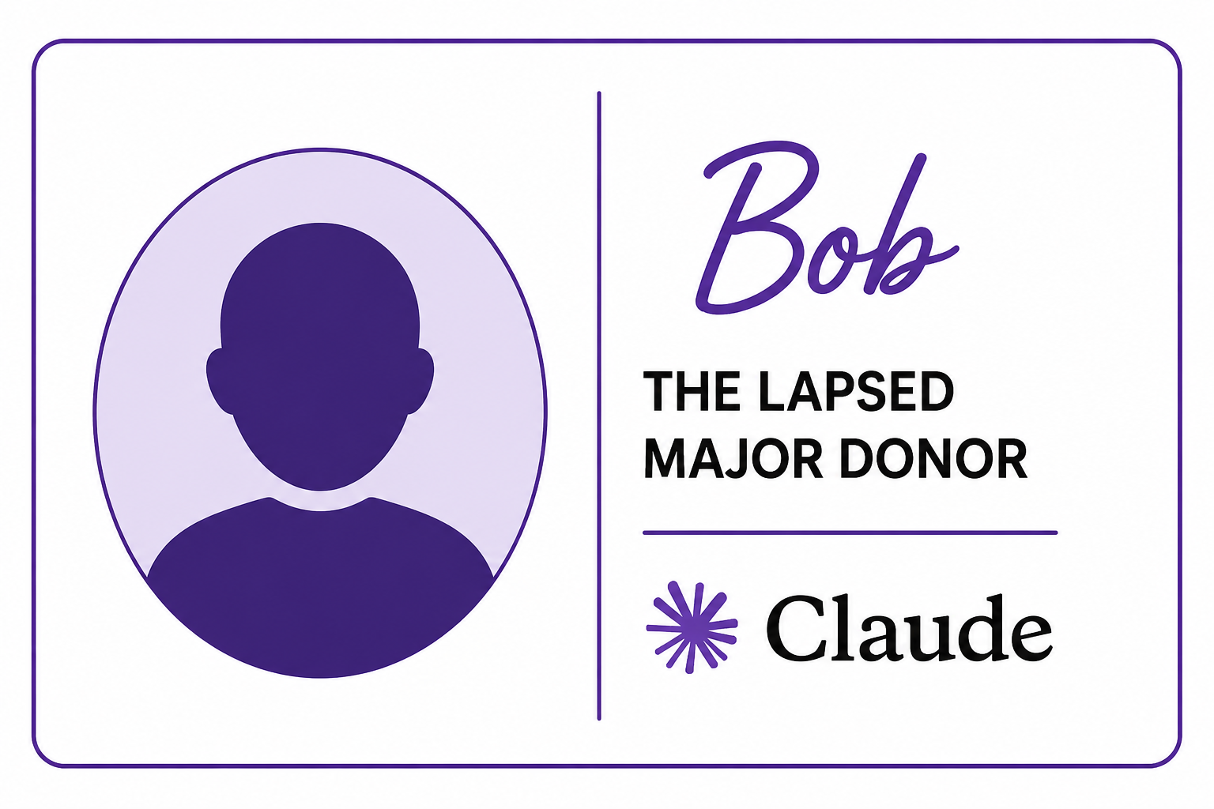
Meet the Donors

Slide 39
Donor One: The Consistent Annual Donor
$1,000 ANNUAL GIFT, EVERY NOV. | 9 yrs CONSECUTIVE GIVING | $500K–700K EST. NET WORTH
GIVING HISTORY | WEALTH INDICATORS | ENGAGEMENT SIGNALS
Gives $1,000 every year in November — like clockwork Has given for 9 consecutive years Always gives by check Has never been asked to increase her gift Attends the annual donor luncheon most years | Owns her Carmel home outright (est. value $380,000) Receives a pension from the Indianapolis Hospital she used to work for Estimated net worth $500,000–$700,000 Also gives to her church and several other Indianapolis organizations | Opens almost every email the food bank sends Handwrites notes on her return envelopes Told staff that volunteering “keeps her going” Always answers when the thank-you caller rings
Background. Peggy is a 64-year-old retired nurse from Carmel, Indiana. She spent 30 years at a hospital in Indianapolis before retiring in 2018. She is widowed, has two adult children, and is deeply embedded in her church and neighborhood community. She volunteers at the local food bank twice a month and has done so for the past six years.
PASTE INTO CHATGPT
Based on this donor profile, please create a personalized outreach plan for Peggy. Include specific talking points for an upgrade conversation and suggested next steps after the first touchpoint. Output a quick 3-month plan with goal and timeline.

Slide 40
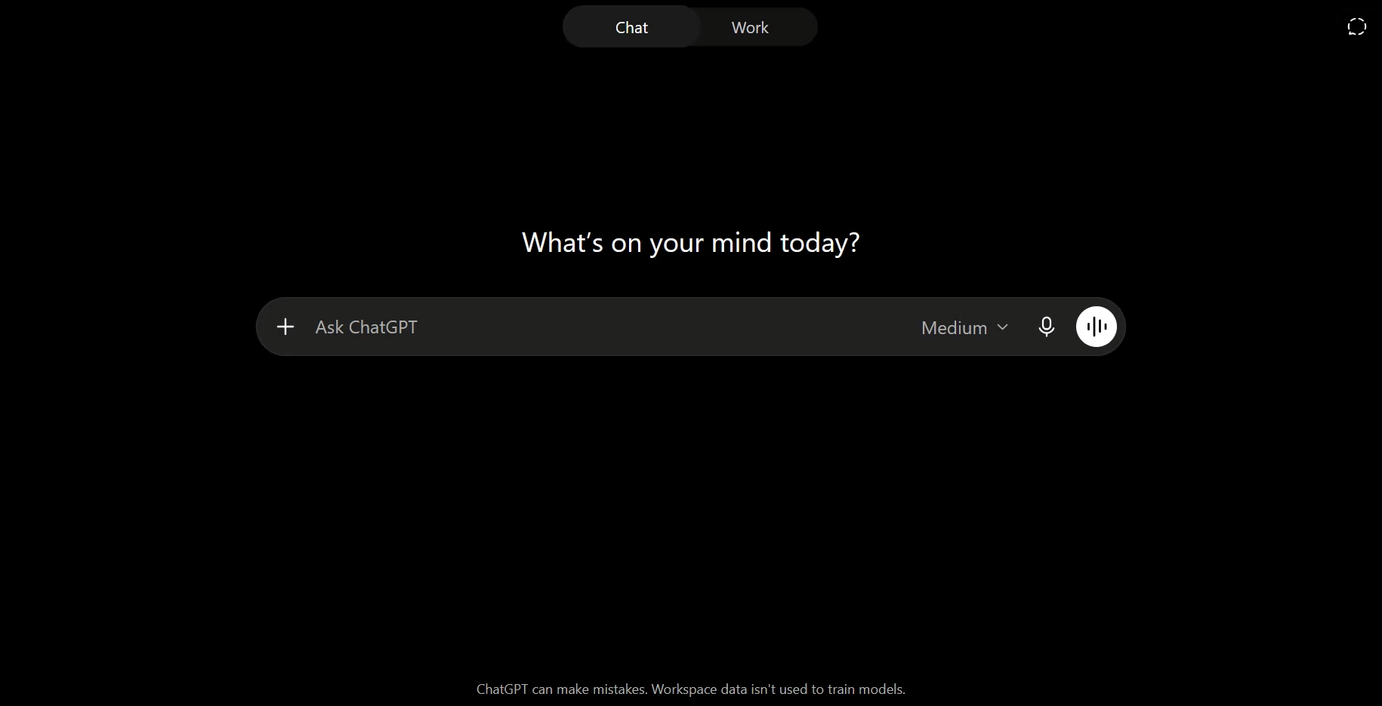
ChatGPT Demonstration: The Consistent Annual Donor

Slide 41
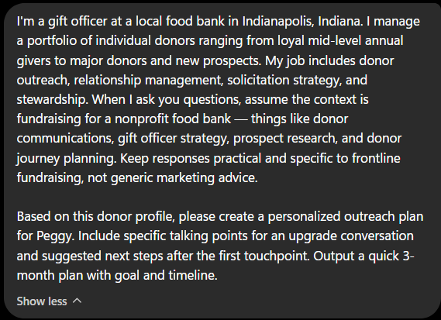
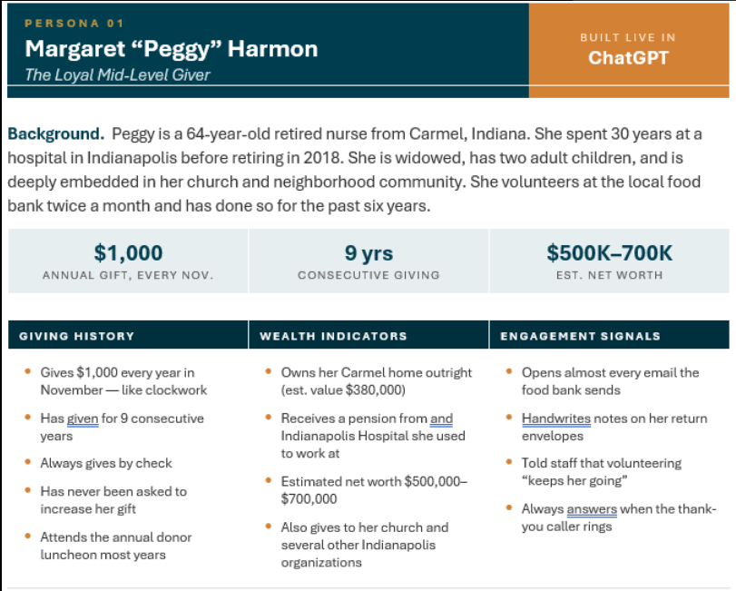
ChatGPT Demonstration: The Consistent Annual Donor
The prompt and data we input into Chat GPT

Slide 42
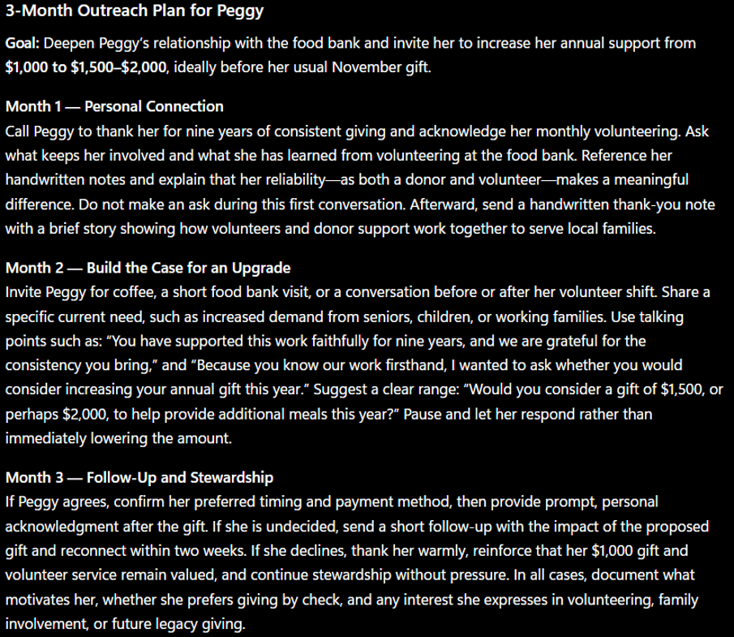
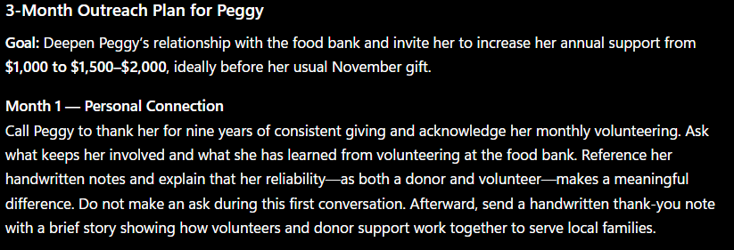
ChatGPT Demonstration: The Consistent Annual Donor
What Chat GPT gave us back

Slide 43
Donor Two: The Lapsed Major Donor
$20,000 LARGEST GIFT (2021) | $3M–5M EST. NET WORTH | 3+ yrs SINCE LAST CONTACT
GIVING HISTORY | WEALTH INDICATORS | ENGAGEMENT SIGNALS
Made a $20,000 gift in 2021 — the largest individual gift that year Gave at smaller levels in 2019 and 2020 before the major gift Has not given since 2021 No personal outreach since his staff contact left in early 2022 | Estimated net worth $3M–$5M Owns multiple commercial properties in Hamilton County Public records show significant gifts to other Indianapolis nonprofits Active Donor Advised Fund with recent grant activity | Has not opened an email in over a year Still follows the organization on social media and occasionally likes posts His wife volunteered at the holiday food drive last November No complaints, no formal lapses, the relationship just went cold
Background. Bob is a 55-year-old commercial real estate developer based in Fishers, Indiana. He runs his own firm, active across the Indianapolis metro for over 20 years. He is married with three kids and sits on the board of a local arts organization. He is well-connected in the Indianapolis business community.
PASTE INTO CLAUDE
Based on this donor profile, draft a personal email from a senior staff member to Bob to re-open the relationship. It should feel warm and genuine — not like a solicitation. No ask yet. We have lost the connection with Bob at our food bank and want to do our best to apologize to Bob and invite him to re-engage.

Slide 44
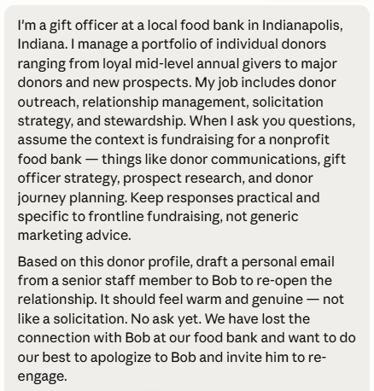
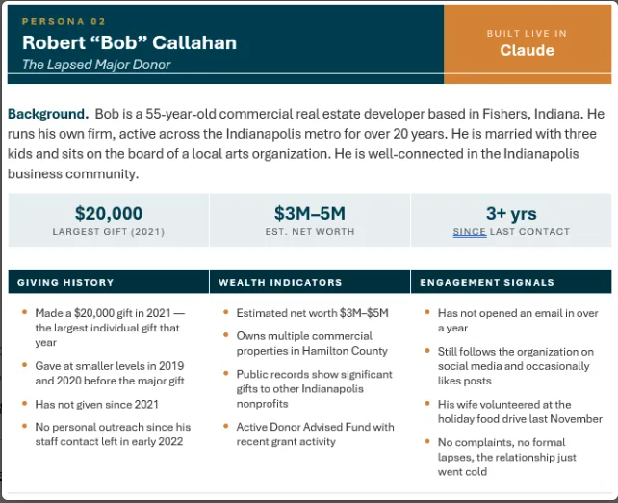
Claude Demonstration: The Lapsed Major Donor
The prompt and data we input into Claude

Slide 45
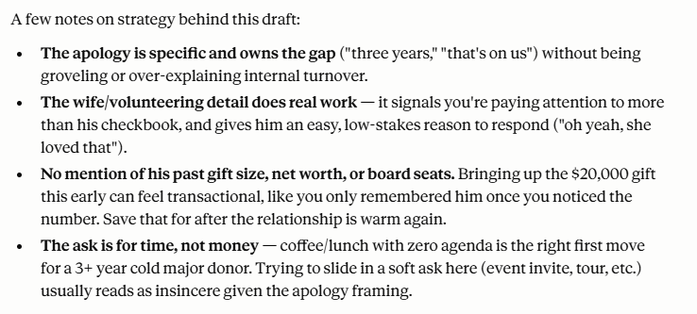
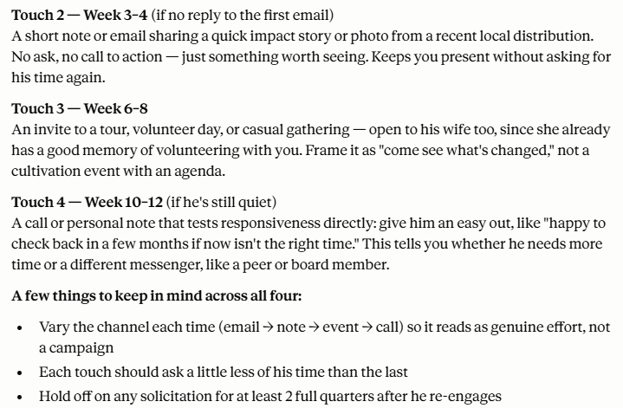
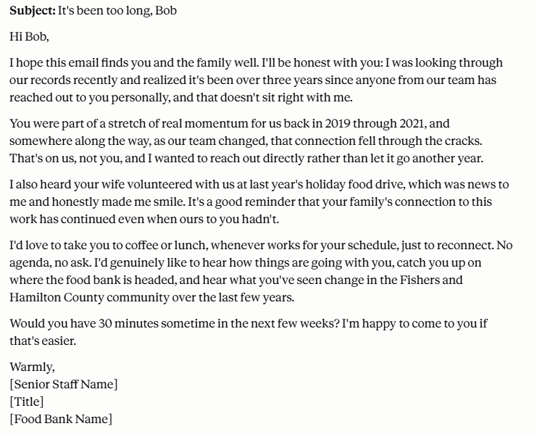
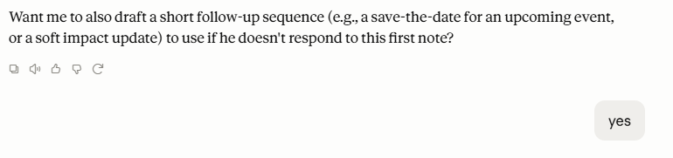
Claude Demonstration: The Lapsed Major Donor
What Claude gave us back

Slide 46
Donor Three: The Newly Engaged, Non-Donor
$180–220K HOUSEHOLD INCOME | $4–6K ANNUAL GIVING ELSEWHERE | 2 VOLUNTEER TOUCHPOINTS
GIVING HISTORY | WEALTH INDICATORS | ENGAGEMENT SIGNALS
No giving history with the food bank yet Attended the spring awareness event in April as a board member's guest Signed up for the email list at the event Volunteered with her family at a Saturday event in June | Estimated household income $180,000–$220,000 Owns an Indianapolis home (est. value $310,000) Gives an estimated $4,000–$6,000 annually to other causes No DAF on record, but income trajectory suggests growing capacity | Has opened every email since signing up Clicked through on a story about childhood hunger in Indianapolis Has asked her board contact follow-up questions about programs Brings her kids to volunteer — a family-level mission connection
Background. Danielle is a 38-year-old marketing director at a mid-sized Indianapolis tech company. She is married with two kids in elementary school and is active in her neighborhood association. She is newer to formal philanthropy but is clearly looking for a place to direct her giving.
PASTE INTO GEMINI
Based on this donor profile, give me 5 leading questions I can ask Danielle in a first qualification meeting to better understand her philanthropic interests, her capacity, and her connection to our mission.

Slide 47
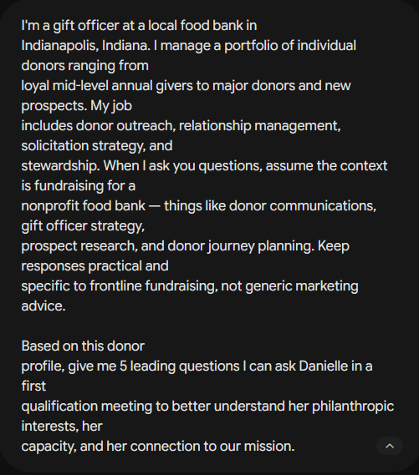
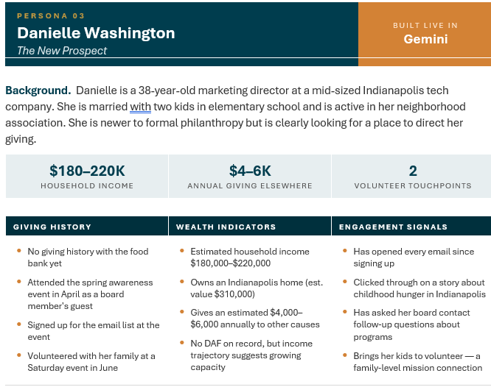
The prompt and data we input into Gemini
Donor Three: The Newly Engaged, Non-Donor

Slide 48
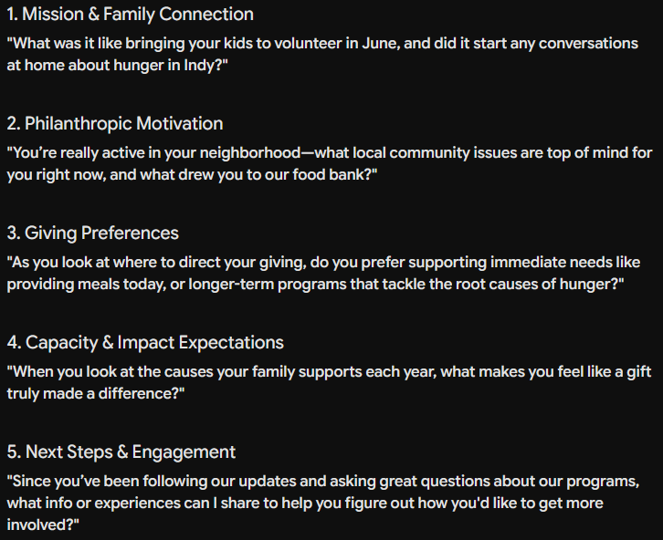
Donor Three: The Newly Engaged, Non-Donor
What Gemini gave us back

Slide 49
3 Takeaways
AI can process the data. Only you understand the person.
The goal was never to replace the relationship — it was to protect your time so you can show up more fully for it.
Think of AI as your first draft, not your final answer.

Slide 50
Beyond the Demonstration
What You Just Experienced:
What’s Possible:
AI supporting individual donor relationships
Personalized recommendations
Individual context
Three interactions
AI supporting all of your donor relationships
Consistent, scalable engagement
Notes:
Make tweaks to this

Slide 51

Donor Engagement Innovation Panel

Slide 52
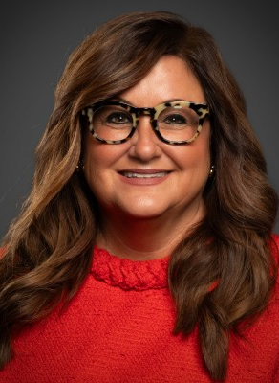
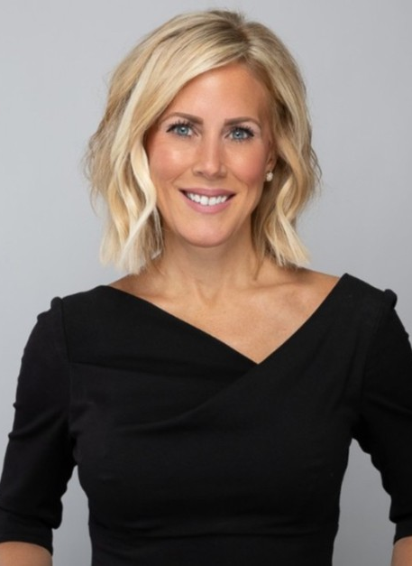
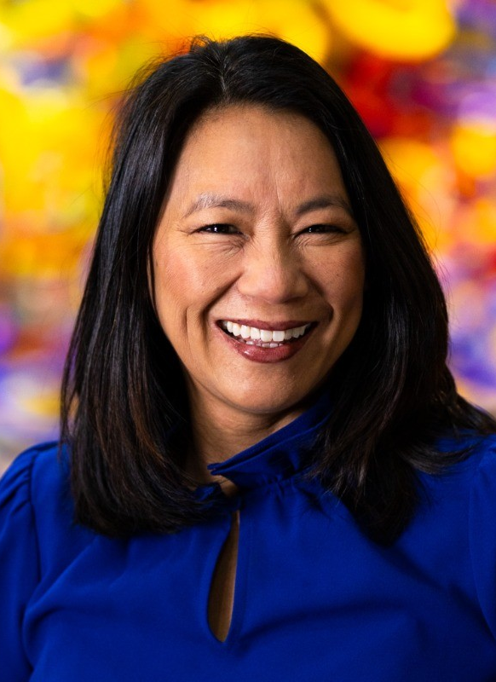
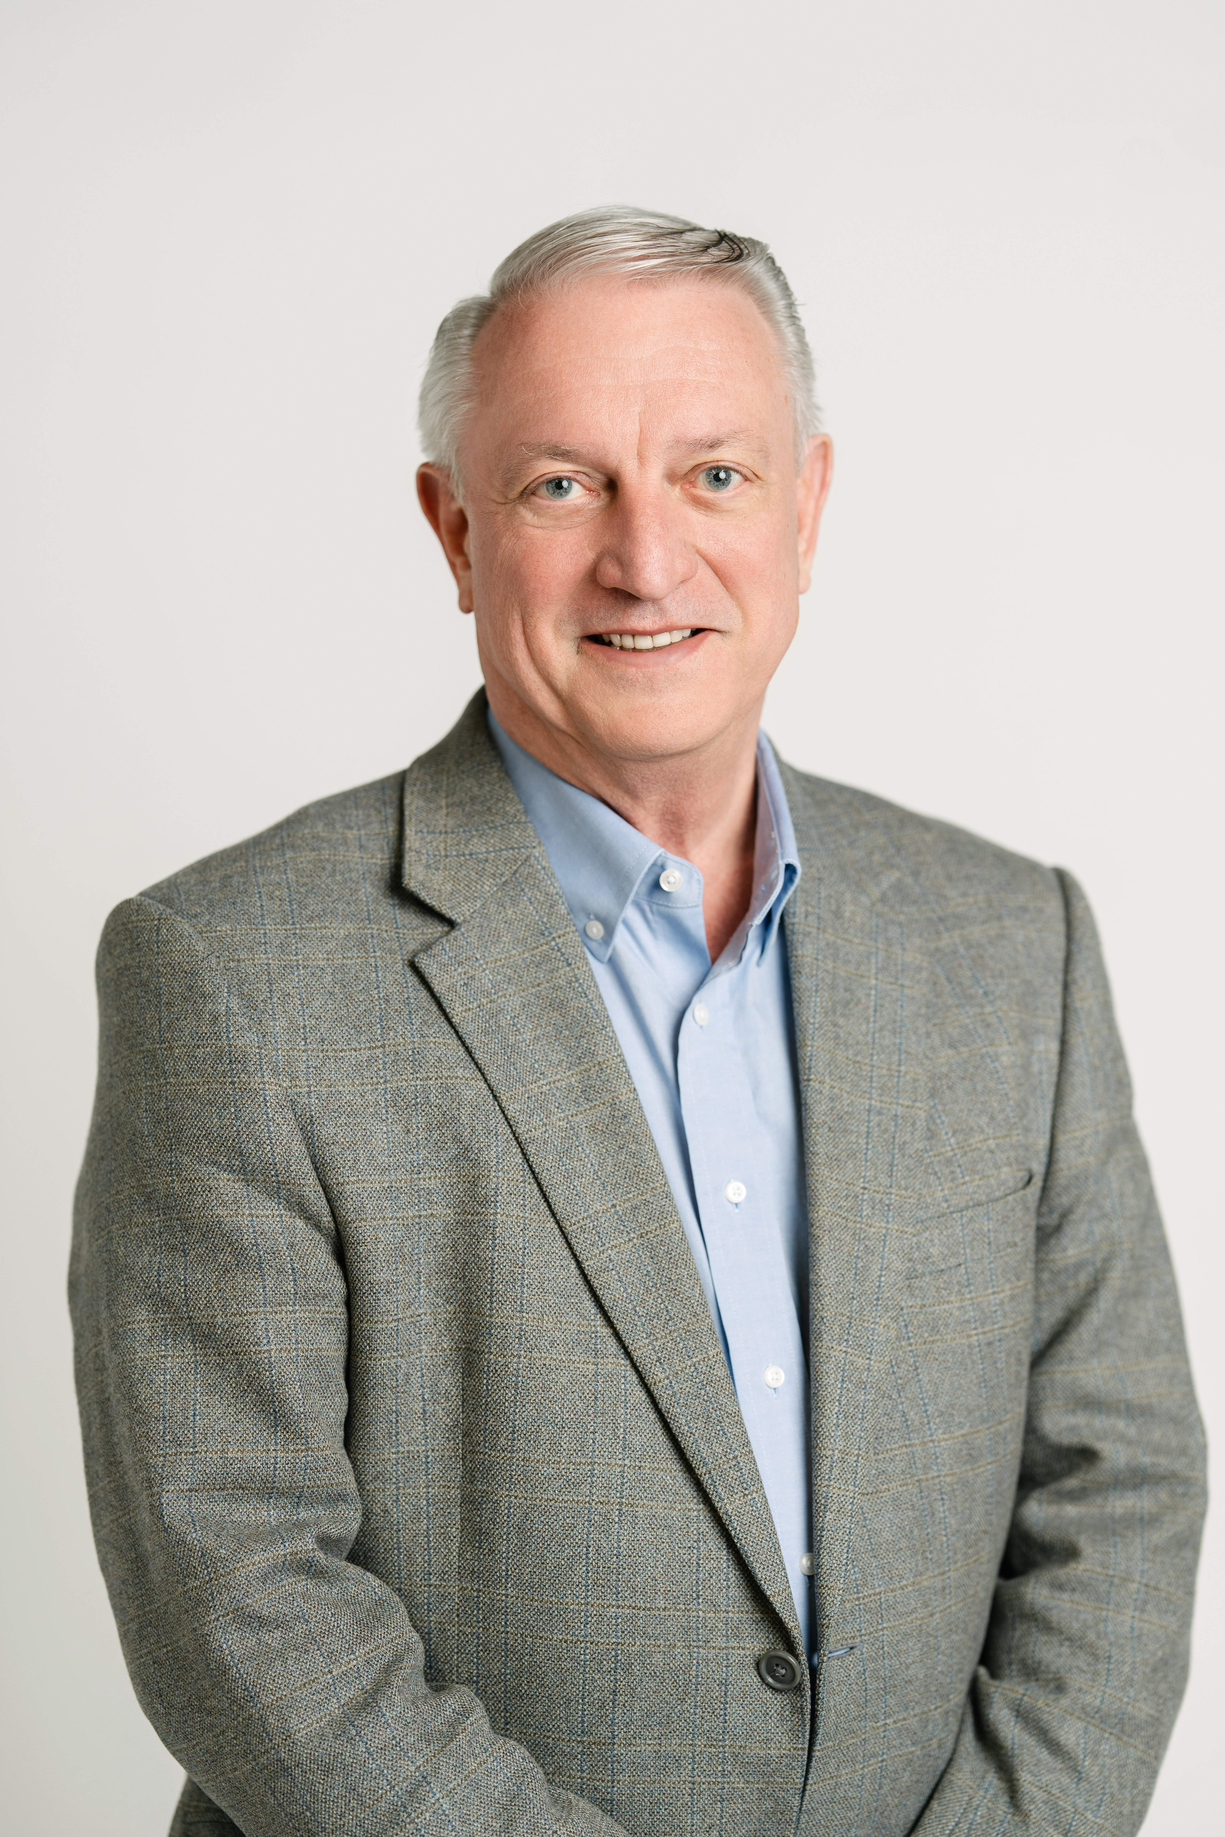
Panelists and Moderator
Panelist
Jean Crosby
President, Ball State Foundation & Alumni Association/Vice President for University Advancement
Ball State University
Panelist
Courtney Roberts
President and CEO
Riley Children’s Foundation
Panelist
Jeannie Infante
Vice President of Advancement
The Children’s Museum of Indianapolis
Moderator
Ted Grossnickle
Senior Consultant and Co-Founder
JGA

Slide 53

Interactive Activity:
How Are You Responding to the Changing Donor Environment?

Slide 54
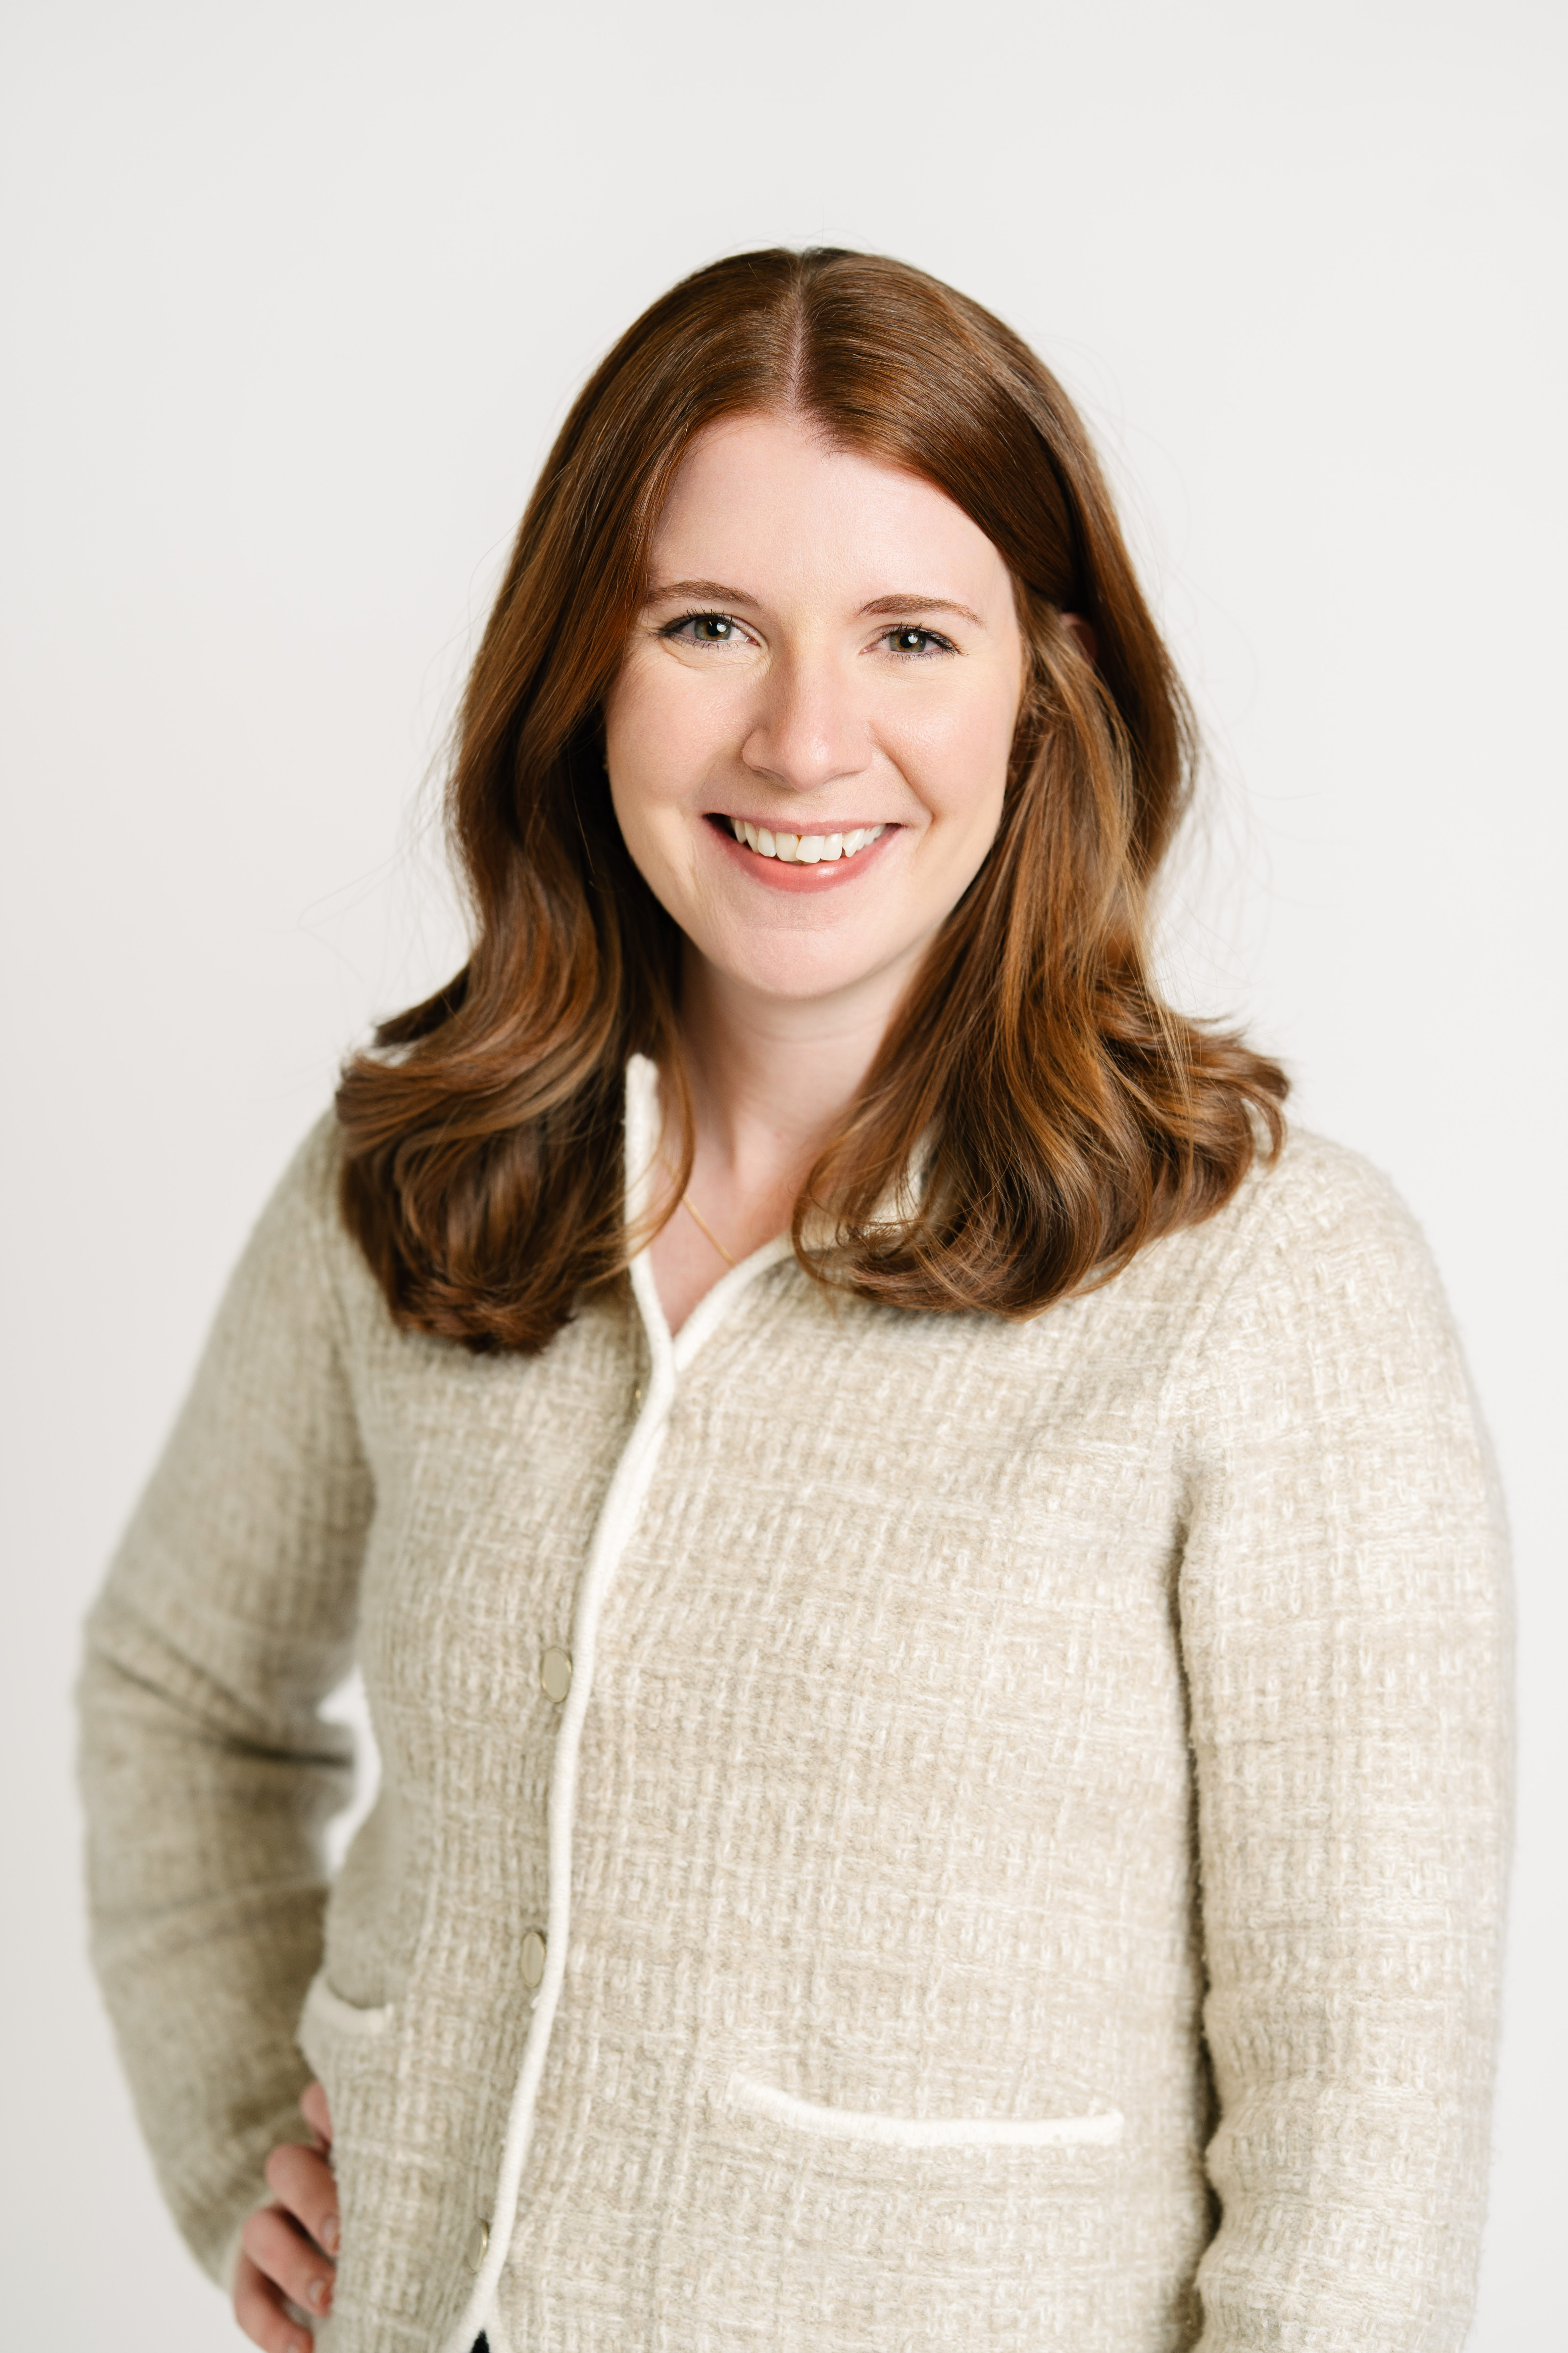
Presenter
Gina Haze
Associate
JGA

Slide 55
Interactive Activity: How Are You Responding to the Changing Donor Environment?
1
2
3
Given the generational shifts and our evolving economy, how have you changed the way that you've communicated with your donors?
From what you heard this morning, what will you apply to your own donor engagement strategies?
Since we’ve just heard from our panelists, take a few minutes to discuss at your table: what changes are you seeing in donor expectations, engagement, or giving behavior?

Slide 56

Fireside Chat: Rethinking Relationships in Community-Centered Giving

Slide 57
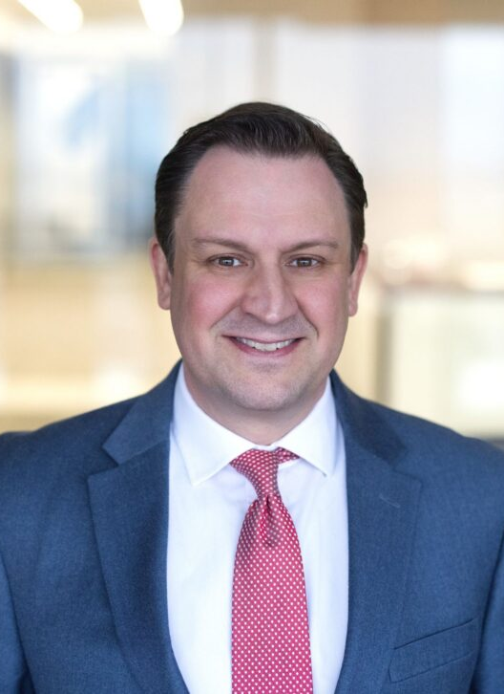
Panelist and Moderator
Panelist
Nathan Chappell
Incoming President & CEO
Nina Mason Pulliam Charitable Trust
Moderator
Lee Ernst
CEO and Senior Consultant
JGA

Slide 58


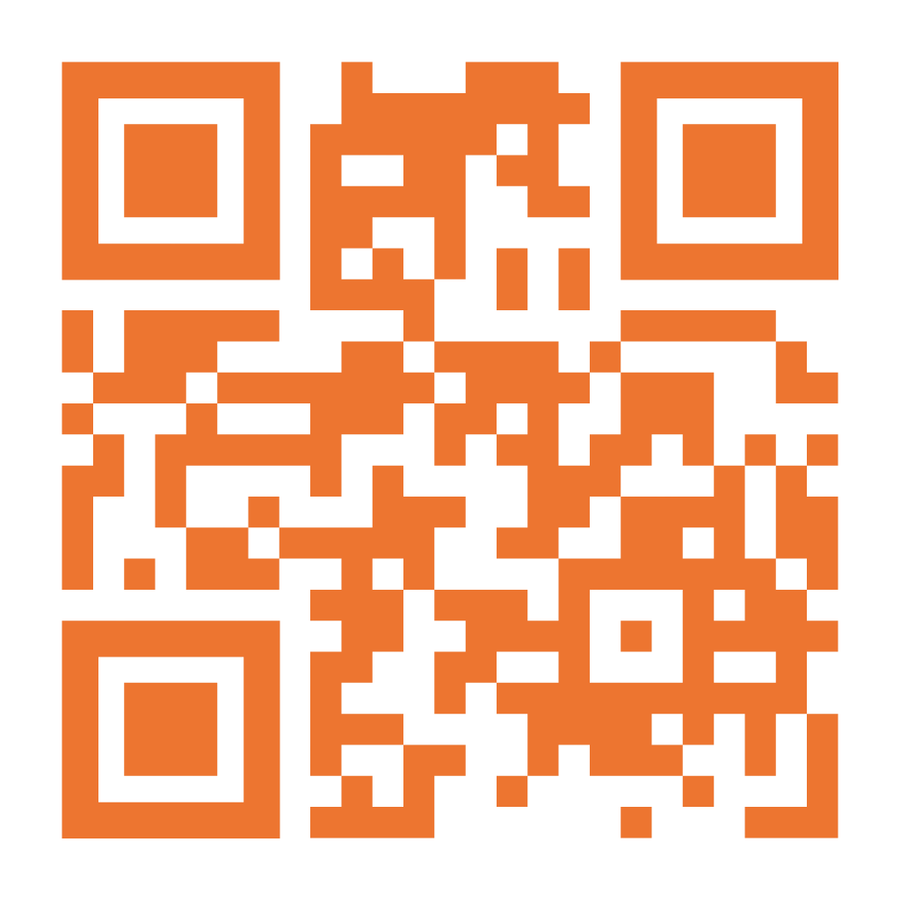
Connect on LinkedIn and Learn More
info@jgacounsel.com jgacounsel.com

